Slide 1
Transport of nutrients by Bacteria
Ms. A. Fasila Begum
Assistant Professor
Department of Microbiology
Jamal Mohamed College
Trichy

Slide 2
Introduction
All microbes have a need for three things: carbon, energy, and electrons.
Nutrients are substances in the environment used by organisms for catabolism and anabolism.
Macronutrients – Required in large amounts
Carbon, oxygen, hydrogen, nitrogen, sulfur, phosphorus (components of carbohydrates, lipid, proteins and nucleic acids)
Potassium, calcium, magnesium, and irons (cations and part of enzymes and cofactors)

Slide 3
Micronutrients – microbes require very small amounts of other mineral elements (Trace elements)
Irons, copper, molybdenum, and zinc
Microbial growth conditions
Macronutrients
Micronutrients
Growth factors – Amino acids, vitamins, purines and pyrimidines
Environmental factors – Temperature, pH, oxygen

Slide 4
Uptake of nutrients
Two problems to be considered during uptake of nutrients by bacteria.
1. Relative concentration
Molecules and ions move spontaneously down their concentration gradient by diffusion.
Molecules and ions can be moved against their Concentration gradient by active transport, but this requires the expenditure of energy (ATP)

Slide 5
2. Lipid bilayers are impermeable to most essential molecules and ions
The lipid bilayer is permeable to water molecules and a few other small, unchanged, molecules like oxygen and carbon dioxide.
These diffuse freely in and out of the cell.
The diffusion of water through the plasma membrane is of such importance to the cell – Osmosis.

Slide 6
Uptake of nutrients
Nutrient molecules frequently cannot cross selectively permeable plasma membranes through passive diffusion and must be transported by one of three major mechanisms involving the use of membrane carrier proteins.
Passive transport
Active transport
Group translocation

Slide 7
Passive Transport
Passive transport is also known as simple or passive diffusion.
Passive diffusion allows for the passage across the cell membrane of simple molecules and gases such as Carbon dioxide, oxygen and water.
Passive transport is a movement of ions and other atomic or molecular substances across cell membranes without need of energy.
The rate of passive transport depends on the permeability of the cell membrane.

Slide 8
In passive transport substances cross the membrane from an area of high concentration to area of low concentration without expenditure of energy.
Three main kinds of passive transport
Simple diffusion
Facilitated diffusion
Osmosis

Slide 9
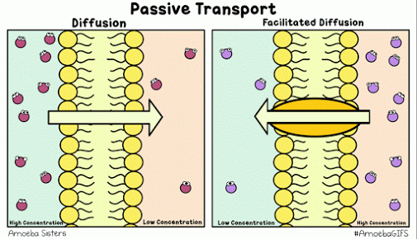
Simple Diffusion
Diffusion is the net movement of material from an area of high concentration to an area of lower concentration.
Simple diffusion is the process by which molecules are moved along a concentration gradient in a solution or across a semipermeable membrane.
Concentration gradient – difference of concentration between the two areas.

Slide 10
Simple diffusion is carried out by the actions of hydrogen bonds forming between water molecules and solutes.
The movement continues until the molecules are evenly distributed.
The point of even distribution is called Equilibrium.

Slide 11
Facilitated Diffusion
It is a form of facilitated transport involving the passive movement of molecules along their concentration gradient.
Movement is guided by the presence of another molecule – usually an integral membrane protein forming a pore or channel.
Facilitated diffusion does not directly involve high energy molecules like ATP.
The substance (glucose) to be transported combines with a carrier protein in the plasma membrane. (Permeases)
Differ from simple diffusion in its use of carriers.

Slide 12
Osmosis
The movement of water across a selectively permeable from a dilute solution (high concentration of water) to a more concentrated solution.
Osmosis is when a substance crosses a semipermeable membrane order to balance the concentrations of another substance.
Osmosis deals with solutions.
A bacterial cell may be subjected to 3 kinds of osmotic solutions: Isotonic, Hypotonic and Hypertonic

Slide 13
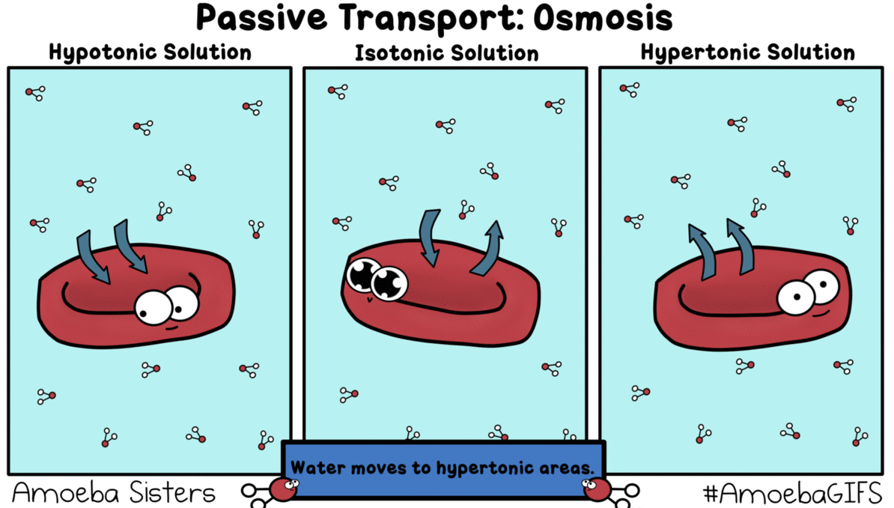
Isotonic
In which over all concentration of solutes are same at both sides (in and out) of the membrane.
Water molecules leaves and enters the cell at the same rate.

Slide 14
Hypotonic
Outside the cells medium whose concentration of solutes is lower than that inside the cell.
When a bacterial cells are placed in a hypotonic solution they may burst as a result of excessive water intake which is known as plasmolysis.
Hypertonic
Opposite of a hypotonic solution. There is the more solute outside the cell than inside it. Most bacterial cell placed in a hypertonic solution shrunk and collapse because water leaves the cells by osmosis resulting in a cell shrinkage

Slide 15
Active transport
Transport of molecules from an area of low concentration to area of high concentration.
Against concentration gradient.
In this process cell use energy (ATP) to move.
Energy dependent transport of solutes from a lower concentration to high concentration via specific membrane bound carrier proteins.
Active transport is most commonly accomplished by a transport protein that undergoes a change in shape when it binds with the cell’s “fuel,” – ATP.

Slide 16
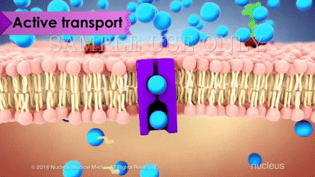
For ex: one type of active transport channel in the cell membrane will bind to the molecule it is supposed to transport – such as a sodium ion – and hold onto it until a molecule of ATP comes along and binds to the protein.
The energy stored in ATP then allows the channel to change shape, spitting the sodium ion out on the opposite side of the cell membrane.

Slide 17
Active transport depends on carrier protein in the plasma membrane.
There are two types of Active transport
Primary active transport
Secondary active transport
Primary active transport
Use of chemical energy such as ATP, to drive the transport.
Ex: ABC system which utilizes ATP binding Cassette Transporter.
ABC transporter is composed of three different proteins.

Slide 18
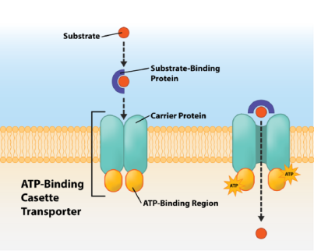
Membrane spanning protein that form a pore across the cell membrane.
ATP binding region that hydrolyses ATP, provide energy for transport.
Substrate binding protein – a peripheral protein that binds to the appropriate substance to be transported.

Slide 19
Secondary active transport
It utilizes energy from Proton Motive Force (PMF).
A PMF is an ion gradient that develops when the cell transport electrons during energy conserving process.
Positively charged protons accumulate along outside of negatively charged cell, creating a proton gradient between the outside and inside of the cell.

Slide 20
There are three different types of simple transport
Uniport
Symport
Antiport
Each mechanism utilizes a different protein porters.
Uniporters transport a single substance across the membrane (In or Out).
Symporter transport two substances across the membrane at the same time.

Slide 21
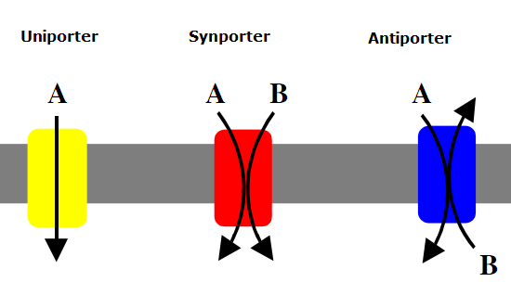
Antiporter transport two substances across the membrane, but in opposite directions.

Slide 22
Group Translocation
Distinctive type of active transport, using energy from an energy rich compound that is not ATP.
The substance being transported is chemically modified in the process.
By attaching a phosphte or co-enzyme A group to the substrate.
Example for Group translocation is Phosphoenolpyruvate
The sugar phospho transferase system (PTS) which uses energy from high energy molecule (PEP) to transport sugars in to the cell.

Slide 23
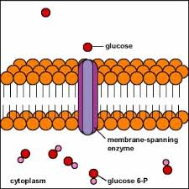
A phosphate transferred from the PEP to the incoming sugar during the process of transportation.
In active transport, solute molecules move across a membrane without modification.

Slide 24
Many prokaryotes take up molecules by group translocation, a process in which a molecule is transported into the cell while being chemically altered.
For example
Phosphoenol pyruvate – Sugar phospho transferase system (PTS).
It transports a variety of sugars while phosphorylating them using phospho enol pyruvate as the donor.
PEP + Sugar Pyruvate + Sugar – P
PTS’s are widely distributed in prokaryotes.

Slide 25
Aerobic bacteria lacks PTS.
Escherichia, Salmonella, Staphylococcus and other facultative anaerobic bacteria have phospho transferase system
Some obligate anaerobic bacteria (Clostridium) also have phospho transferase system.
Many carbohydrates are transported by these systems.
E.coli takes up glucose, fructose, mannitol, sucrose, N-acetyl glucosamine, celloboise and other carbohydrates by group translocation.

