Slide 1
Antigen and Antibody Interactions
A.Fasila Begum
Assistant Professor of Microbiology
Jamal Mohamed College (Autonomous)
Trichy-20

Slide 2
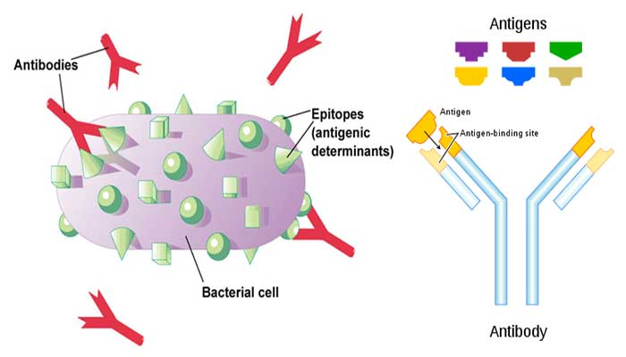
Outline
Introduction
Features
Types
Mechanism
Application

Slide 3
Introduction
Interaction between antigen and antibody. (Ag-Ab interactions)
The antigens and antibodies combine specifically with each other.
Antigen and antibody interaction is a bimolecular association. (Enzyme-substrate interaction)
Antigen-Antibody reactions is the basis of humoral immunity or antibody mediated immune response.
Ag-Ab interactions are depends on four types of non covalent interaction: Hydrogen bonds, Ionic bonds, Hydrophobic interactions and Vander waals interactions.
When Ag-Ab reactions occur invitro – Serological reactions

Slide 4
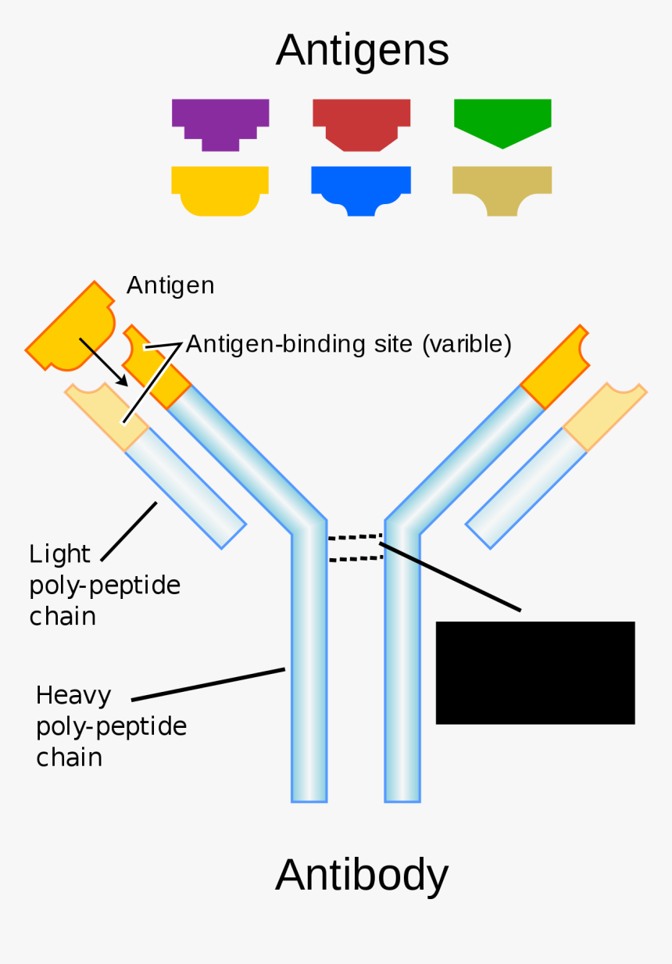
Reactions occur in three stages:
Formation of Ag-Ab complex.
Visible events like precipitation and agglutination.
Destruction of Ag or its neutralization.
The binding takes place between the epitopes of antigen and paratopes of antibodies.
Binding takes place at the surface of the cell.

Slide 5
Features
Immune complex
Specificity of Ag – Ab reactions
Binding sites of antigen and antibody
Binding forces of antigen and antibody
Avidity
Bonus effect
Cross reaction
1. Immune complex
Antibody binds with the antigen to form a complex molecule called Immune complex or Ag-Ab complex.
2. Specificity of Ag-Ab Reaction
Reaction is highly specific. Specificity refers to discriminate ability of a particular antibody to combine with only one type of antigen. Each antigen has a separate antibody. (Lock & Key system)
Ag + Ab Ag-Ab complex

Slide 6
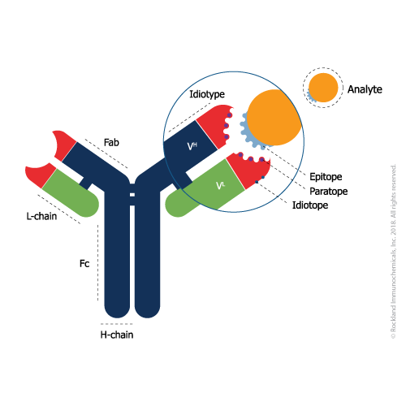
3. Binding sites of Antigen and antibody
Epitope or Antigenic determinant - Part of antigen which combines with antibody (10 -15).
Paratope or antigen binding site - Part of antibody which combines with antigen. Antibodies are bivalent or multivalent.
4. Binding forces of Antigen and Antibody
Binding is due to three factors:
a) Closeness between antigen and antibody
When they are closely fit the strength of binding is great.

Slide 7
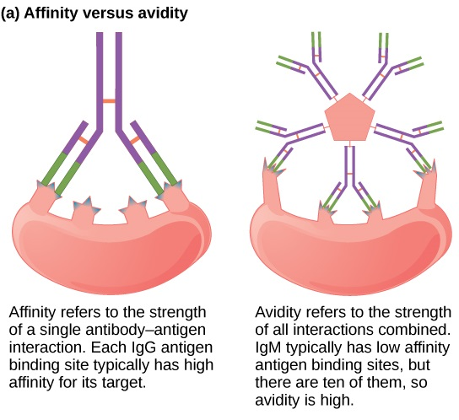
b) Intermolecular forces – 4 types
c) Affinity of antibody
The strength of a bond between a particular paratope of a antibody and a single antigenic determinant. It denotes binding capacity of an antibody with univalent antigen.
5. Avidity
The combined strength of multiple bond interactions between multivalent antigens and multivalent antibodies.
It denotes overall capacity of antibodies to combine with multivalent antigens.

Slide 8
Multivalency helps the antibodies to surround the pathogen on all sides so that all antigen cannot escape from the warfare of antibodies.
6. Bonus Effect
Giving extra strength to Ag-Ab complex by the binding of two antibodies and two antigen molecules.
Here antigens are bridged by a single antibody. It increases the binding strength of antigen and antibody molecules.
7. Cross Reaction
The reaction of antigen with a closely related antibody.
Cross reactive antigen - The antigen which produces the cross reaction.
It is due to the presence of one or more identical antigenic determinants.

Slide 9
Types of Antigen – Antibody Reactions
Brought about by the contact of antigen and antibody.
This reaction leads to visible manifestations such as Agglutination, Precipitation, etc.
Precipitation
Agglutination
Cytolysis
Complement fixation
Flocculation
Opsonization
Immunofluorescence

Slide 10
Precipitation
An antigen-antibody reaction between a soluble antigen and its antibody resulting in the formation of insoluble precipitate.
Precipitin – Antibody causing precipitation.
Mechanism
Antigen is multivalent and antibody is bivalent.
Antibody is a bivalent molecule so it can bridge a two multivalent antigens.
Bridging leads to the formation of lattice which forms precipitate.
If the Antigen and antibody are in a optical concentration, the large lattice is formed so the precipitation is complete.
Precipitin test
Test of antigen-antibody reaction.
The amount of precipitate formed is determined by the proportion of Ag and Ab.

Slide 11
Three zones of precipitin curve
Zone of antibody excess
Zone of equivalence
Zone of antigen excess
Applications
Find out the amount of antibody present in the serum of an immunized animal.
VDRL test is based on Ag-Ab reaction – Syphilis.
Hepatitis B antigen can be identified.
Basic principle for the following technique
Single immunodiffusion
Double immunodiffusion
Radial immunodiffusion
Immuno electrophoresis
Rocket immunodiffusion

Slide 12
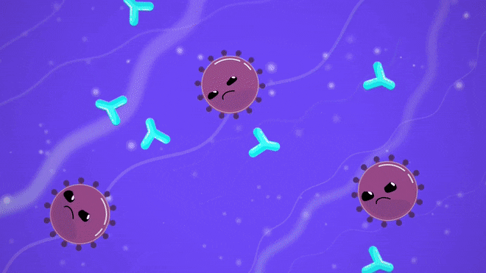
2. Agglutination
The antibody of the serum causes the cellular antigens to adhere to one another to form clumps. (Clumping of particular Ag and Ab)
Agglutinins – Antibodies that causing agglutination.
Agglutinogens – Particulate antigens aggregated. (Bacteria, virus, RBC, etc)
Haemagglutination – RBC agglutination.
Bcaterial agglutination – Bacterial cells agglutination

Slide 13
Mechanism
Brought about by linking of Ag and Ab.
Antibodies are bivalent, multivalent (IgM). So they link more number of antigens and form clumps.
Agglutination test
The examination of clump formation when particulate antigen and antibodies are combined.
Applications
ABO & Rh blood grouping
Widal test
Coomb’s test – identification of anti-Rh antibodies
Well felix – typhus
Brucella agglutination test - Brucellosis

Slide 14
3. Cytolysis
Dissolution of the cell.
Haemolysis – RBC is lysed.
Bacteriolysis – Bacterial cell is lysed.
Lysis caused by complement-fixing union between antibody and cell bound antigen.
Mechanism
Ag-Ab complex activates complement
Activated complement binds to the surface of complex
Complement form MAC on the pathogen
MACs make holes on the plasma membrane of pathogen
Contents released and cell is lysed

Slide 15
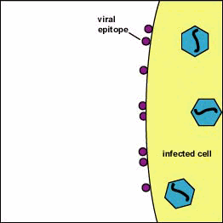
Complement fixation & Cytolysis

Slide 16
4. Complement fixation
The binding of complement to antigen and antibody complex.
Ag-Ab complex activates the complement 1 (C1). It binds with immune complex.
This causes a cascade complement activation.
By product of complement is Membrane Attack Complex (MACs).
They are deposited on the surface of pathogen, and make holes in plasma membrane of the pathogen.
So the contents of the cells are flow-out, this leads to lysis of the pathogen.

Slide 17
5. Flocculation
Brought about by exotoxins and antitoxins.
They produces floccules which do not sediment and remain dispersed in the medium.
6. Opsonization
Process by which antibodies bind to a pathogen and the pathogen is marked for killing by Phagocytes.
Opsonin – Marking substance
It is a molcecule that targets antigen and stimulates an immune response.
Acts as a binding enhancer for the process of phagocytosis.
Molecules that activates the complement system.
Molecules that target a cell for destruction through action of NK cells.
Eg: Ab – IgM & IgD, Complements – C3b, C4b, C3bi, Mannose –lectin.

Slide 18
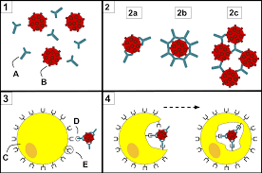
Mechanism
Fab portion of the opsonin binds to the receptor of pathogen.
Results in the formation of antigen-opsonin complex, then the antigen is opsonized.
Opsonized antigen is marked for destruction.
Opsonized antigen is killed in three ways:
Phagocytosis
Complement activation
Antibody dependent cellular cytotoxicity

Slide 19
7. Immunofluorescence
Phenomenon of emitting radiation by antibodies labelled with fluorescent dyes.
Antibodies are mixed with fluorescent dyes (fluorescein or rhodamine) emit radiations.
Immunofluorescence can be observed by a fluorescent microscope. Technique of immunostaining.
Helps to visualize the location of antibodies in the sample.
Used to analyse the distribution of proteins, glycans, DNA, etc in tissue sections, cultured cell lines
Principle
Antibodies are conjugated to a fluorescent dye.
Labelled Ab binds to the specific antigen, and the antigen is detected through fluorescent techniques.

Slide 20
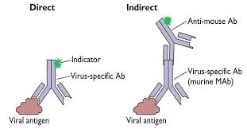
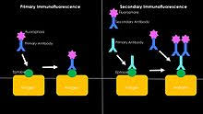
Methods of Immunofluorescence
Three methods:
1. Direct method
2. Indirect method
3. Sandwich method
Applications of Immunofluorescence
Used to locate and identify antigens in tissues.
Certain pathogenic bacteria can be identified.
Antibodies directed to cell or antigen can be detected.

Slide 21
Role of Antigen and antibody interactions
It immobilizes, agglutinate and precipitate the pathogens.
Brings about opsonization of pathogen.
Brings about Ab dependent cellular cytotoxicity.
Brings about complement fixation and result in the lyse of the pathogen.
Helps in blood grouping.
Harmful effects of antigen-antibody interactions
The reaction causes all types of Hyper sensitivity reactions includes allergy reaction, Anaphylaxis, Rheumatic fever, Serum sickness and Erythroblastosis foetalis.

