Slide 1
READING TYPES SKIMMING & SCANNING
K. Nisha
Assistant Professor
Department of English
Jamal Mohamed College
Trichy-20

Slide 2
SUB HEADINGS
INTRODUCTION
SKIMMING
SCANNING
READING TIPS
STUDY READING

Slide 3
INTRODUCTION
Reading is the process of gaining meaning from point.
Reading involves the use of eyes and brain . In order to read fast you need to use more of your brain
Reading can be either oral or silent
There are two specific type of reading :
1.SCANNING
2.SKIMMING

Slide 4
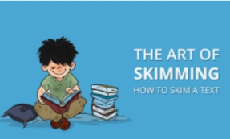
SKIMMING
Skimming sometimes referred to as gist reading.
It help to know what the text is about at its most basic level.
Typically do this with magazine or newspaper.
Typically skim to search for a name in a telephone directory.
Read Speed Count – 700 words per minute.

Slide 6
USES
SKIMMING IS A QUICK READING TO GET
It is useful when you want to survey a text to get a general idea of what is about.
In this, you ignore the details and look for the main idea.
It is also useful to pay attention to the organisation of the text.
To know general meaning of the passage , how the passage is organized.

Slide 7
WHEN IT IS USED
To get an idea of the intention of the writer.
Skimming is more complex task than scanning because it requires reader to organize & remember some information by author.
When reading some general question in mind.
Used for the initial survey and for review.
Skimming is a skill that a student may want to develop to continue with academic studies.
Used in reviewing for a test.

Slide 8
SCANNING
It is just scan the guide book to see which site you might want to visit .
Scanning a simple piece of information .
Reading of the paper is far more conducive to speedy comprehension of texts .
It is special attention of introduction and conclusion
Scanning – quick reading, focusing ,specific information .

Slide 9
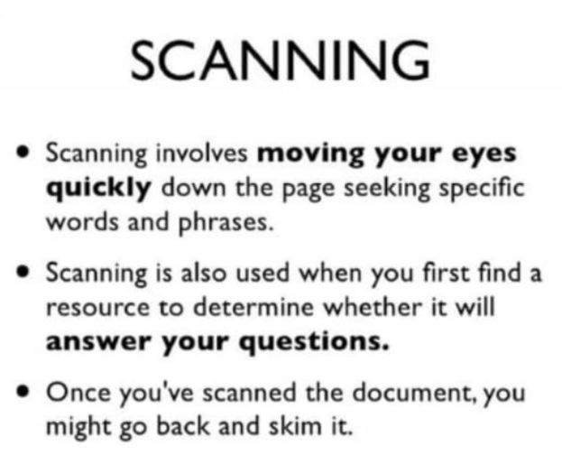

Slide 10
SCANNING USES
Scanning – quick eye movements to find important information .
Scanning is used to such as a name. date. Symbol, formula ,
Little information –long term memory
Scanning – uses technical scientific or professional to locate specific information.
Scanning is a valuable skill second language learners

Slide 11
READING TIPS
As soon as you define the topic – “ What general point does the author want to make about this topic? – You can answer that question - found the main idea .
Most main ideas – suggested early on in a reading – special attention – the first third of any passage, article , or chapter – clearest expression of the main idea .
Pay attention to any idea – repeated in different ways- Author returns same thought in several different sentences or paragraphs – main idea .
Once you feel sure – found the main idea – examples , reasons , facts included in the reading - evidence or explanation in support of the main idea you have in mind.
The main idea of a passage can be expressed any number of ways – author only give a good title for any passage .

Slide 12
STUDY READING
The reader must get a maximum understanding of main ideas and their relationship .
There are two methods:
1) SQ3R
2) SQ4R

Slide 14
WHAT IS SQ4R READING METHOD ?

Slide 15
CRITICAL READING
Here you question , analyze , and evaluate the text – use critical – thinking skills to :
differentiate between fact and opinion
recognize author’s purpose in writing
make inference about purposes and characters
recognize the author’s tone in writing

Slide 16
ANALYTICAL READING:
EX : Raman brought 7 watermelon , 5 jackfruits and Kannan brought 6 watermelon ,7 jackfruit. The cost of watermelon and jackfruit is Rs 25 and Rs 30 respectively .find the total amount of purchasing fruits by each .

Slide 17
Thank You

