Slide 1
SECURTY ANALYSIS AND PORTFOLIO MANAGEMENT
CAPITAL MARKET - SECONDARY MARKET
DR. F. WAHIDHA BEGUM
ASSISTANT PROFESSOR
JAMAL INSTITUTE OF MANAGEMENT
JAMAL MOHAMED COLLEGE, TRICHY

Slide 2
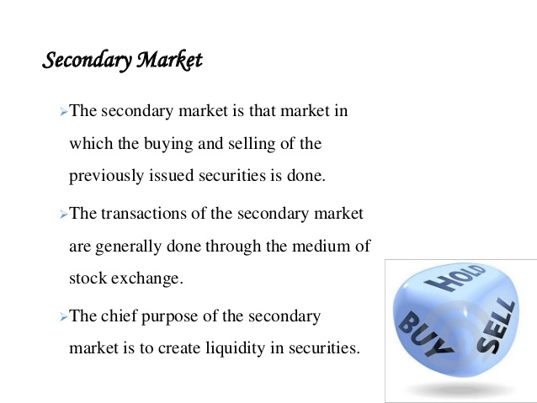

Slide 3
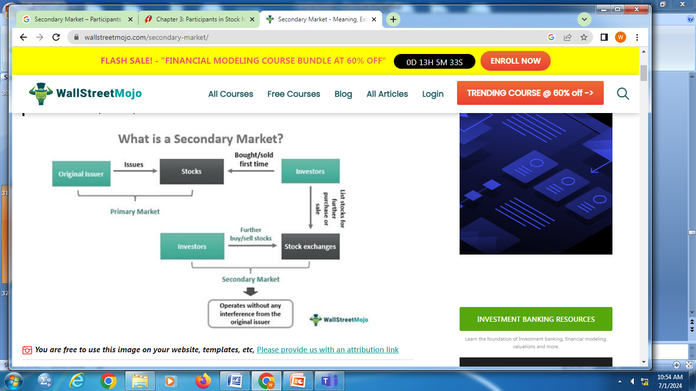

Slide 4
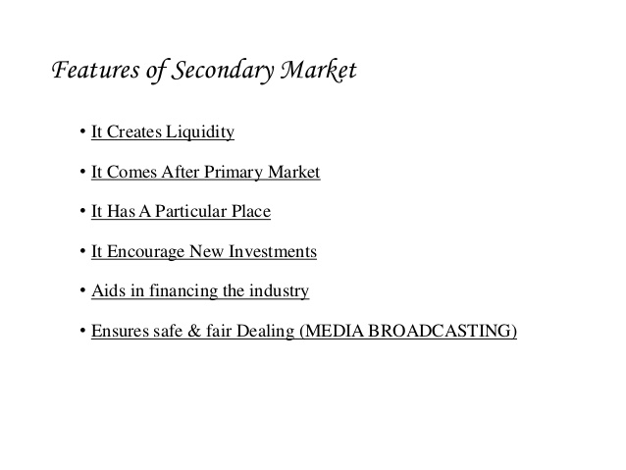

Slide 5
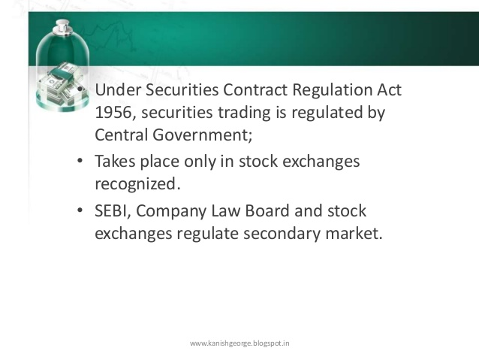

Slide 6
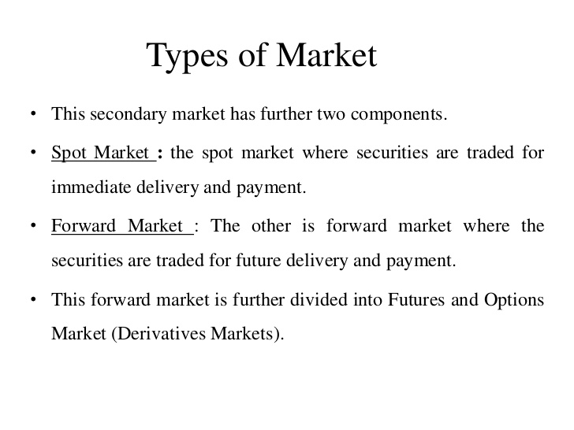

Slide 7
Importance of a Secondary Market
Helps measure the economic condition of a country. The rise or fall in share prices indicates a boom or recession cycle in an economy.
Provides a good mechanism for a fair valuation of a company.
Helps drive the price of securities towards their genuine, fair market value through the basic economic forces of supply and demand.
Promotes economic efficiency. Each sale of a security involves a seller who values the security less than the price and a buyer who values the security more than the price.
The secondary market allows for high liquidity.

Slide 8
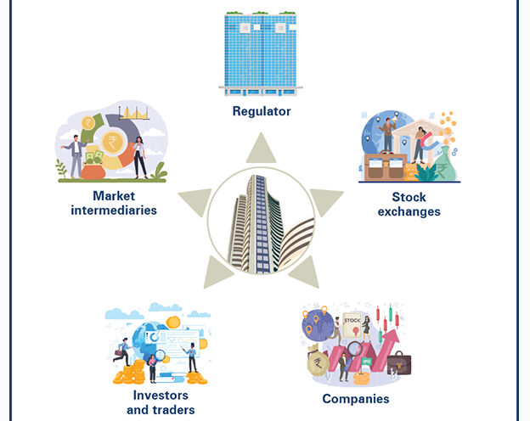

Slide 9
Regulator
stock market and the entities involved that are engaged in financial activity.
The goal of this regulator is to ensure that fraud is prevented, and if taken place is investigated thoroughly. They help keep markets efficient and transparent. And more importantly ensure that investors such as you are treated fairly and honestly.

Slide 10
There are various regulators for different sectors of the financial market like Ministry of Finance, RBI, SEBI (Securities and Exchange Board of India), IRDA (Insurance Regulatory and Development Authority), PFRDA (Pension Fund Regulatory and Development Authority) etc.
For the Indian Stock Market, SEBI is the regulator to ensure that the securities market functions efficiently and works smoothly.

Slide 11
Stock exchanges
The stock exchange also known as a securities exchange is a trading platform. It facilitates the registered stockbrokers and investors, often through a stock trading app, to transact in securities electronically.
India has two premier stock exchanges include National Stock Exchange (NSE) and the and BSE Limited (BSE).

Slide 12
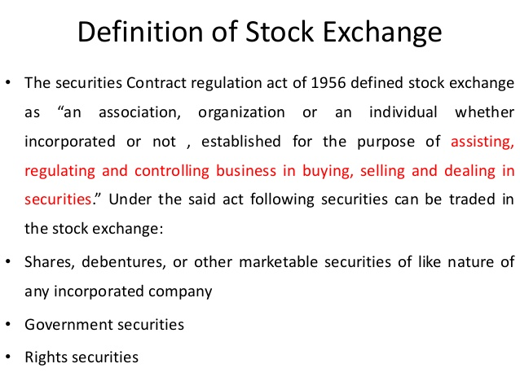

Slide 13
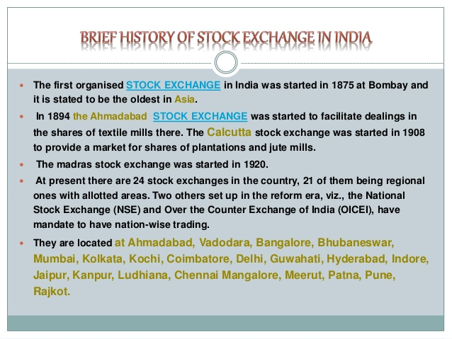

Slide 14
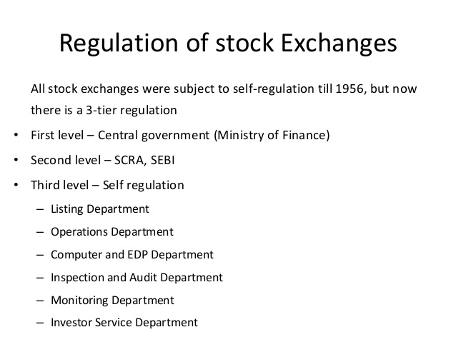

Slide 15
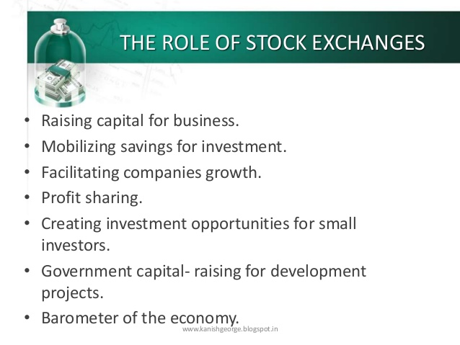

Slide 16
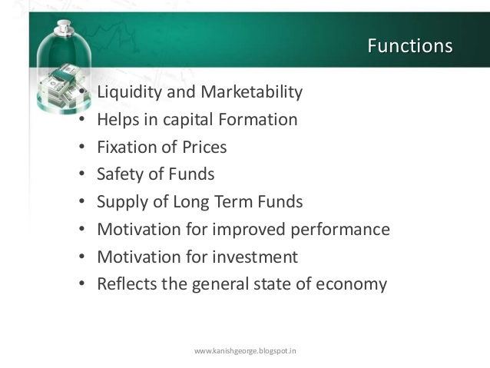

Slide 17
Companies
Every share that available to be purchased or sold in the stock market today are those issued by publicly traded companies.
When a company makes an Initial Public Offer (IPO), it becomes publicly traded, which means it introduces itself in the stock exchange.

Slide 18
Investors and traders
Trading and investing are two very different activities. But when you invest in a publicly listed company in the stock exchange, you are regarded as an investor.
If you are looking to buy into a security for a short-term horizon with the intention of profiting from price fluctuation in a stock, you are regarded as a trader.

Slide 19
Types of Investor
Retail investors – These are investors who invest in the stock market directly.
Institutional investors – These are typically financial institutions like banks, Asset Management Companies (AMC), insurance companies, pension funds, etc. The investors could be domestic or foreign. We now arrive at the fifth and final stock market participant — market intermediaries

Slide 20
Market intermediaries
Intermediaries are entities that are involved in a financial transaction in the market apart from the buyer and seller. These are institutions that help you carry out your investment activity smoothly while ensuring all the rules laid out by the regulator are met.

Slide 21
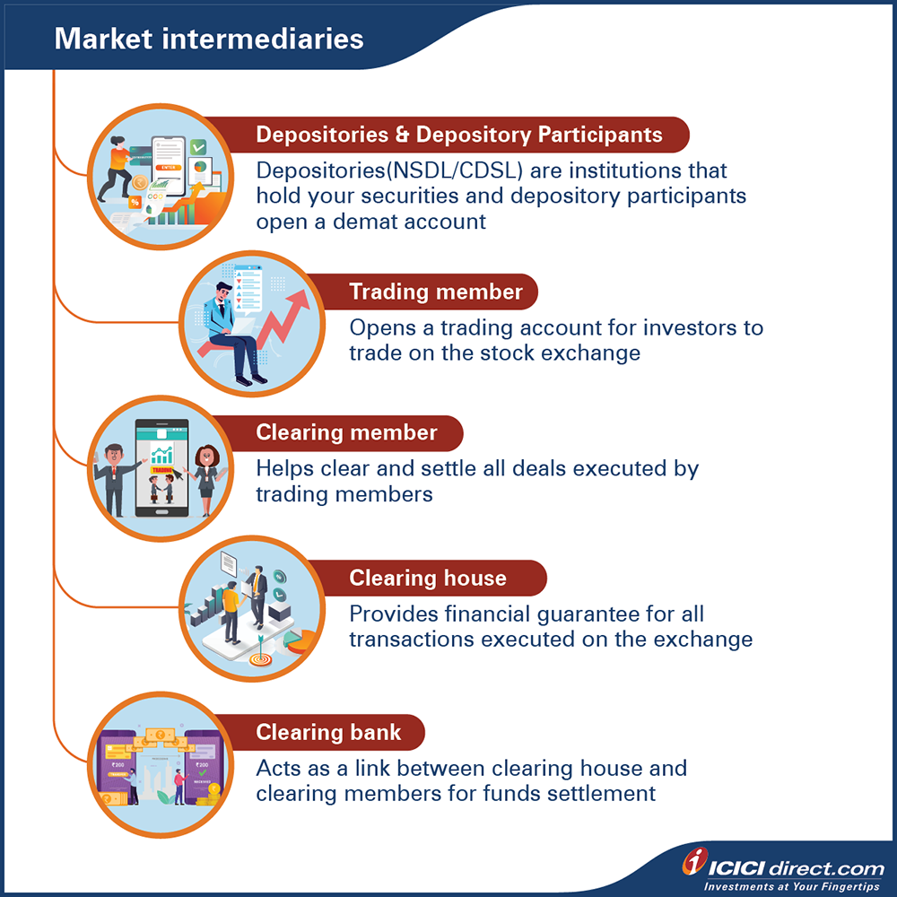

Slide 22
