Slide 1
Demand Forecasting in Supply Chain Planning
Armaan Salik J

Slide 2
What is Demand Forecasting?
Demand forecasting is a predictive process that estimates future customer demand for a product or service using historical data, market trends, and other influencing factors. This process enables businesses to make informed decisions regarding production, inventory management, resource allocation, and supply chain operations.

Slide 3
Why is Demand Forecasting Essential in Supply Chain Planning?
Aligning Supply with Demand: Ensures that resources are efficiently allocated to meet expected customer needs, minimizing waste and optimizing costs.
Improving Customer Satisfaction: By anticipating customer requirements, businesses can ensure timely delivery and reduce the likelihood of stockouts.
Enabling Proactive Decision-Making: Allows companies to plan for market fluctuations, seasonal variations, and unexpected disruptions.
Cost Optimization: Helps in managing inventory costs by avoiding overproduction or excessive stock levels.
Strategic Planning: Supports long-term decisions such as entering new markets, capacity expansion, or launching new products.

Slide 4
Objectives of Demand Forecasting
Minimize inventory costs
Avoid stockouts and overstocking
Optimize resource allocation
Enhance customer satisfaction
Support strategic and tactical decisions

Slide 5
Importance in Supply Chain
Balances supply with demand
Improves operational efficiency
Reduces lead times
Helps in strategic planning (e.g., market expansion)
Enhances responsiveness to market changes

Slide 6
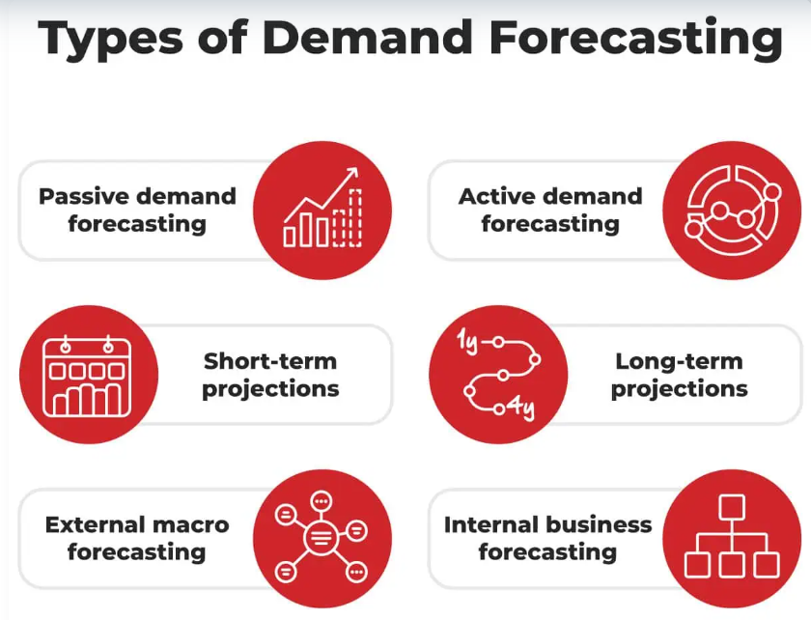

Slide 7
1. Passive demand forecasting
Passive demand forecasting uses sales data from the past to predict future demand.
This is the simplest type of demand forecasting, because it doesn’t require you to use statistical methods or study economic trends. This approach assumes that this year’s sales will be approximately the same as last year’s sales.
The passive forecasting model works well if you have solid sales data to build on. This model works best for businesses that prioritize stability over growth.

Slide 8
2. Active demand forecasting
An active forecasting model takes into consideration your market research, marketing campaigns, and expansion plans.
If your business is in a growth phase or if you’re just starting out, active demand forecasting is a good choice to help you make informed decisions.
Active projections often consider external factors, such as:
  Economic outlook
  Growth projections for your market sector
  Projected cost savings from supply chain differences
Startups that have less historical data to draw on will need to base their assumptions on external data.

Slide 9
3.Short-term projections
Short-term demand forecasting only looks at the next three to 12 months.
This type of demand forecasting is useful for managing your just-in-time supply chain. Looking at short-term demand allows you to adjust your projections based on real-time sales data and respond quickly to changes in customer demand.
If you run a product lineup that changes frequently, understanding short-term demand is important. For most businesses, however, a short-term forecast is just one piece of a larger puzzle. You’ll probably want to look further out with medium- or long-term demand forecasting.

Slide 10
4. Long-term projections
Your long-term demand forecast will make projections one to four years into the future.
This forecasting model focuses on shaping your business growth trajectory. While your long-term planning will be based partly on sales data and market research, it is also aspirational.
Think of a long-term demand forecast as a roadmap. Using this forecasting technique, you can plan out your marketing, capital investments, and supply chain operations. That will help you to prepare for future demand. Being ready for your business growth is crucial to making that growth happen.

Slide 11
5. External macro forecasting
External macro forecasting incorporates trends in the broader economy, examines how those trends affect your goals on a macro-level, and gives you direction on how to meet those goals.
Your company may be more invested in stability than expansion, but you still need to consider external market forces to ensure accurate sales projections. External macro forecasts address the availability of raw materials and other factors that directly affect your supply chain.

Slide 12
6. Internal business forecasting
Internal business demand forecasts review your operations to ensure you can meet customer demand and growth goals.
One of the limiting factors for your business growth is internal capacity. If you project that customer demand will double, your enterprise needs to have the capacity to meet that demand.
The internal business forecasting type uncovers limitations that might slow your growth. It can also highlight untapped areas of opportunity within the organization. This forecasting model factors in:
Business financing
Cash on hand
Profit margins
Supply chain operations
Personnel
Internal business demand forecasting is a helpful tool for making realistic projections. It can also point you toward areas where you need to build capacity in order to meet expansion goals.

Slide 13
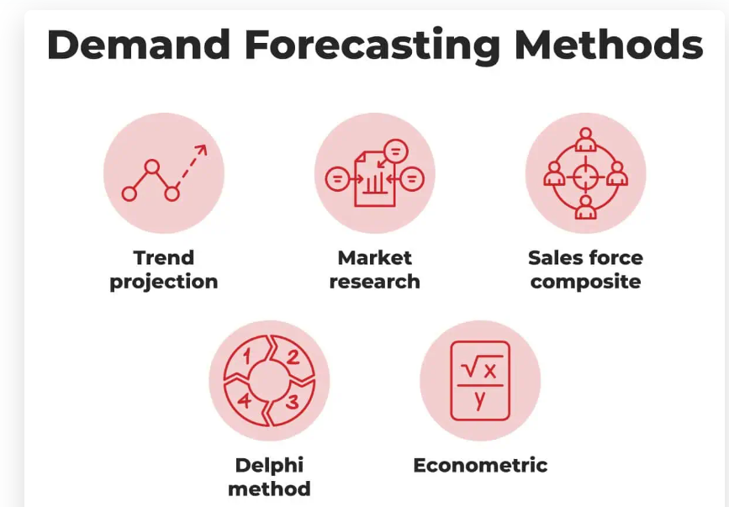

Slide 14
1. Trend projection
Trend projection uses your past sales data to project your future sales.
It’s important to adjust future projections to account for historical anomalies.
For example, perhaps you had a sudden spike in demand last year, but it happened after your product was featured on a popular television show, so it is unlikely to repeat. Or maybe your ecommerce site got hacked, causing your sales to plunge. Be sure to note unusual factors in your historical data when you use the trend projection method.

Slide 15
2. Market research
Market research demand forecasting is based on data from customer surveys.
This method gives you a picture of your typical customer you can’t get from internal sales data.
Your surveys can collect demographic data that will help you target future marketing efforts.
Market research is particularly helpful for young companies that are just getting to know their customers.

Slide 16
3. Sales force composite
The sales force composite demand forecasting method puts your sales team in the driver’s seat. It uses feedback from the sales group to forecast customer demand.
Your salespeople have the closest contact with your customers. They hear feedback and take requests, which makes them a great source of data on customer desires, product trends, and competitor strategies.
This method gathers the sales division with your managers and executives. The group meets to develop the forecast as a team.

Slide 17
4. The Delphi method
The Delphi method, or Delphi technique, is a qualitative method of demand forecasting that leverages expert opinions on your market forecast.
This method requires engaging outside experts and a skilled facilitator. To complete the Delphi method, follow these steps:
Send a questionnaire to a group of demand forecasting experts.
Create a summary of the responses from the first round.
Share the results with your panel.
Repeat the process through successive rounds.
This demand forecasting method allows you to draw on the knowledge of people with different areas of expertise.

Slide 18
5. Econometric
The econometric method is a quantitative type of forecasting that combines sales data with information on outside forces that affect demand.
You use this combination of data to create a mathematical formula that predicts future demand.
The econometric demand forecasting method accounts for relationships between economic factors.
For example, an increase in personal debt levels might coincide with an increased demand for home repair services.

Slide 19
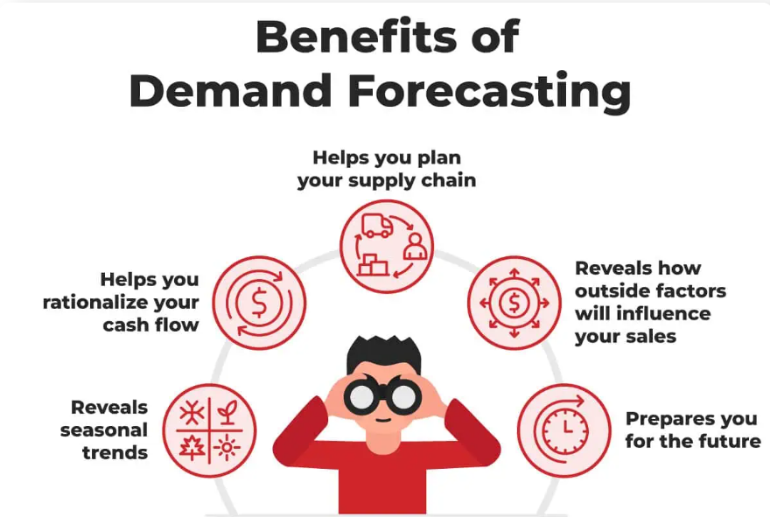

Slide 20
Benefits
Reveals seasonal trends.
A review of historical sales data will reveal seasonal fluctuations to inform your sales forecasting. Beyond busy holiday seasons, it’s also important to know which months have less customer demand. If your sales take a dip every February, that could be a good time to offer discounts to engage customers.
Helps you rationalize your cash flow.
Your past balance sheet will show you how sales revenue meshes with costs of goods sold. This data can show you when you will have the cash on hand to keep inventory levels where they need to be.

Slide 21
Benefits
Helps you plan your supply chain.
Demand forecasting will help you with capacity and inventory planning so you can have inventory on hand when customer demand spikes. This strategy will keep you from incurring rush charges and putting items on backorder as you scramble to fill orders.
Reveals how outside factors will influence your sales.
Forecasts can include data about industry trends, the state of the economy, and projections for your market sector. Bringing these factors into your forecasting model can help you be ready to adapt and grow your business.

Slide 22
Benefits
Prepares you for the future.
Every business has to be ready to weather the unexpected, whether it’s a natural disaster or a new competitor that eats into your market share. Demand forecasting prepares your supply chain and business for future shocks.

Slide 23
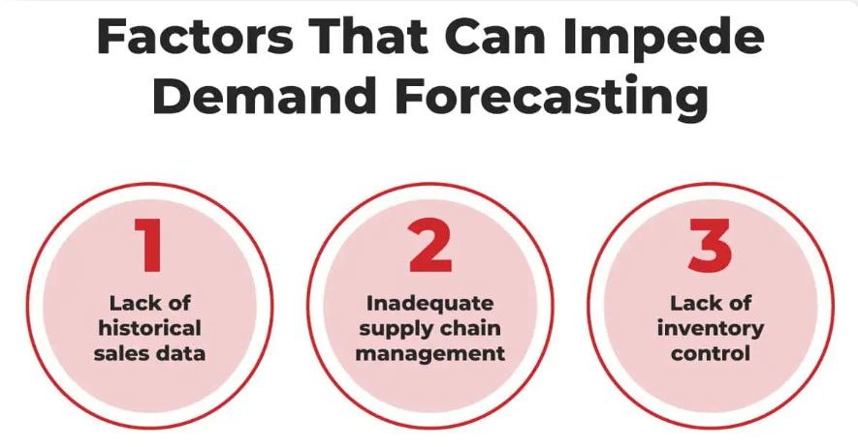
Issues with demand forecasting

Slide 24
Issues Explained
Lack of historical sales data.
This problem commonly arises for companies without much of a track record, but, even more established businesses can struggle. Compile and organize sales data from past years into a format that’s easy to use.
Inadequate supply chain management.
The best demand forecast won’t help you if your supply chain isn’t predictable and well-managed. You need to know the exact lead time series required for the allocation of raw materials, to produce finished goods, and to ship them to your order fulfillment warehouse.
Lack of inventory control.
Good inventory management is the foundation of good demand planning. If you don’t have a handle on what you have in the warehouse, you can over- or underestimate your production. Fortunately, your 3PL services provider can help you with that.

Slide 25
Demand forecasting best practices
Share data up your supply chain.
Data silos create inefficiency. Keep communication lines open with every level of your supply chain and make sure information flows in both directions.
Use redundant sourcing.
Relying on one supplier can lead to backlogs if that supplier has a production problem. Diversify your sources to protect your supply chain.
Track the results of your demand forecasts.
Revisit past forecasts to learn from your mistakes. How accurate was your last forecast? Did your demand forecasting techniques work well? Or do you need to look to different models for actionable results?
Leverage your 3PL to avoid dead stock.
Dead stock consists of items that never sell. This merchandise can linger on warehouse shelves for years, costing you money without bringing in revenue. Your eCommerce fulfillment company (or 3PL) can help you avoid dead stock with transparent inventory.

Slide 26


