Slide 1
Activity-Based Costing (ABC)

Slide 2
Introduction
Definition of Activity-Based Costing (ABC): ABC is a costing methodology that assigns costs to products and services based on the activities required to produce them.
Importance of ABC in Cost Management: Helps organizations identify high-cost activities, allocate costs more accurately, and improve decision-making.
Comparison with Traditional Costing Methods: Unlike traditional costing, which assigns overhead costs based on labor or machine hours, ABC assigns costs based on actual resource consumption.

Slide 3
Key Concepts of ABC
Cost Drivers: Factors that cause costs to be incurred (e.g., number of machine setups, labor hours, or batches processed).
Activities: Tasks or processes that consume resources and contribute to cost accumulation (e.g., quality inspections, order processing).
Resource Allocation: The distribution of costs from resources to activities and then to cost objects.
Overhead Distribution: ABC helps distribute indirect costs more accurately compared to traditional methods.

Slide 4
Steps in Implementing ABC
Identify Activities: List all significant activities performed in the production or service process.
Assign Costs to Activities: Determine the total cost associated with each activity.
Identify Cost Drivers: Establish the factors that influence the cost of each activity.
Allocate Costs to Products/Services Based on Usage: Assign costs to products or services based on how much of each activity they consume.

Slide 5
Advantages of ABC
More Accurate Cost Allocation: Provides a realistic assignment of indirect costs.
Better Understanding of Cost Behavior: Helps in analyzing cost patterns and cost reduction opportunities.
Improved Decision-Making: Assists in pricing strategies, budgeting, and profitability analysis.
Helps in Eliminating Non-Value-Added Activities: Identifies and reduces wasteful activities.

Slide 6
Disadvantages of ABC
Time-Consuming and Expensive to Implement: Requires detailed activity tracking and data collection.
Requires Significant Data Collection: Demands constant updates and monitoring.
Complex to Maintain and Update: Needs regular adjustments as business processes evolve.

Slide 7
ABC vs. Traditional Costing
Feature | Traditional Costing | Activity-Based Costing (ABC)
Basis of Allocation | Direct labor/machine hours | Activity-based cost drivers
Accuracy | Less accurate | More precise cost distribution
Complexity | Simpler and easier to implement | More detailed and complex but insightful
Best Suited For | Companies with uniform products | Companies with diverse products and processes

Slide 8
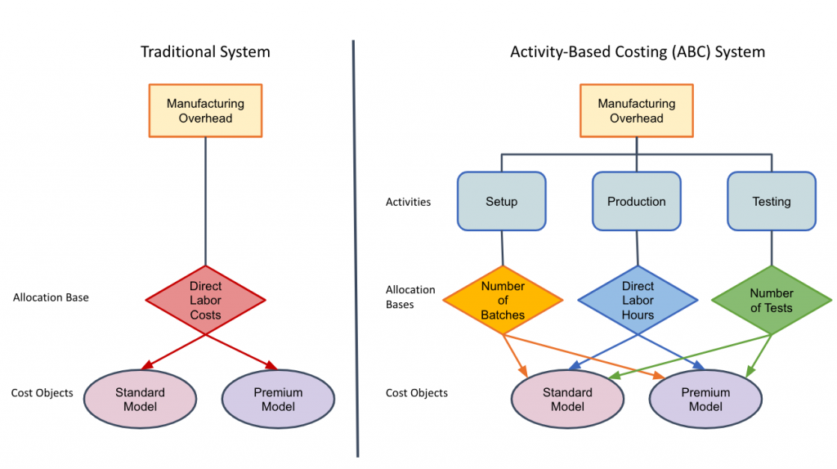

Slide 9
Real-World Applications
Manufacturing Industries: Helps in pricing, cost reduction, and profitability analysis.
Service Sector (e.g., Healthcare, Banking): Assists in cost allocation for patient care, loan processing, and other service activities.
Retail and Logistics: Enhances supply chain efficiency by identifying high-cost distribution activities.
IT & Software Development: Useful for tracking costs related to software development, testing, and maintenance.

