Slide 1

SECURTY ANALYSIS AND PORTFOLIO MANAGEMENT
CAPITAL MARKET
PRIMARY MARKET
Dr. F. WAHIDHA BEGUM
ASSISTANT PROFESSOR
JAMAL INSTITUTE OF MANAGEMENT
JAMAL MOHAMED COLLEGE, TRICHY

Slide 2
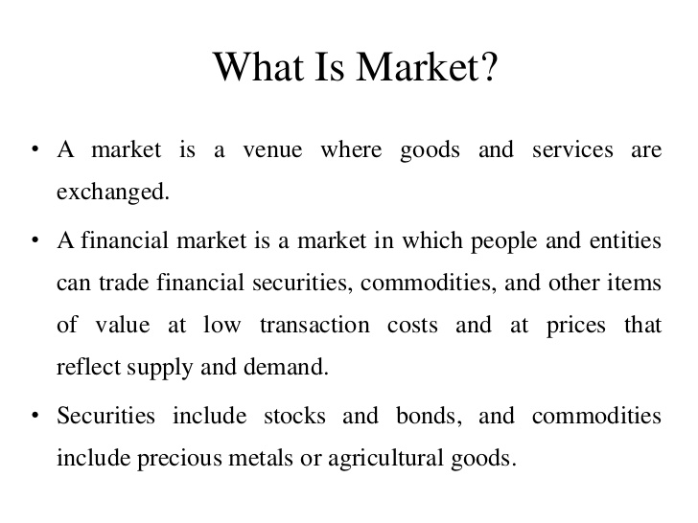

Slide 3
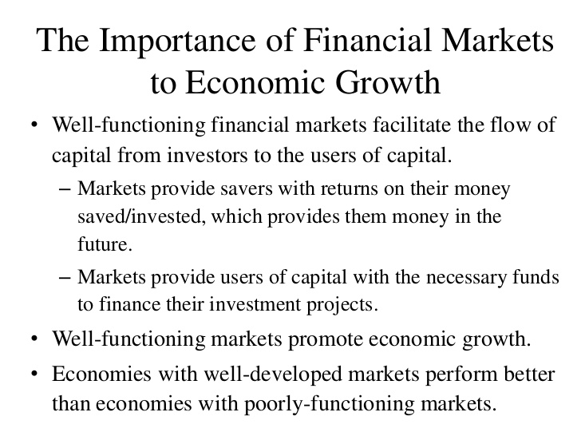

Slide 4
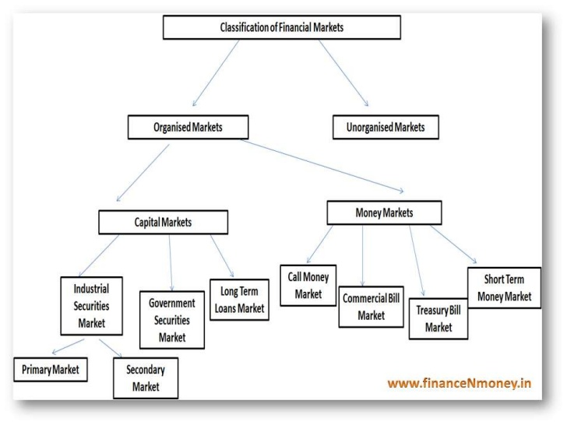

Slide 5
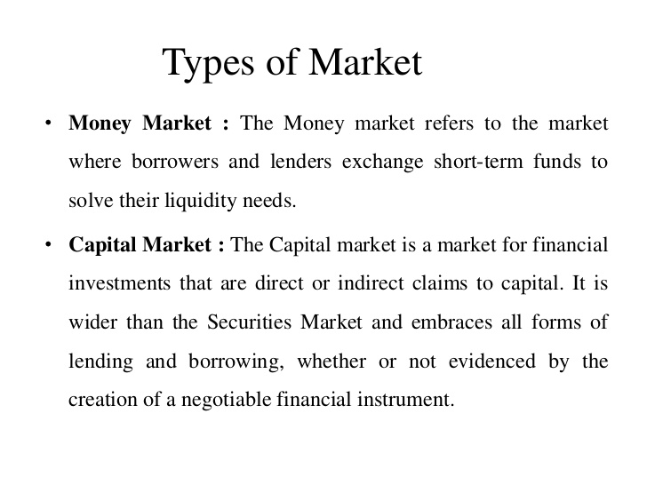

Slide 6
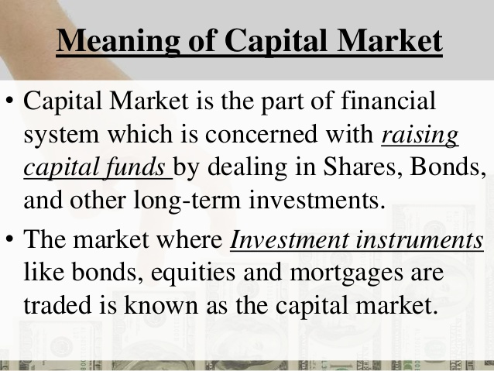

Slide 7
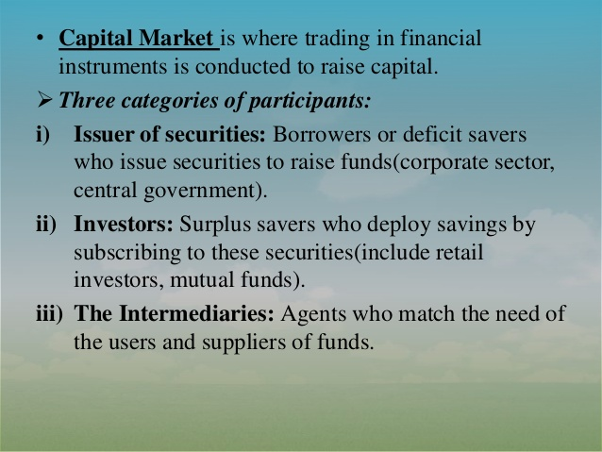

Slide 8
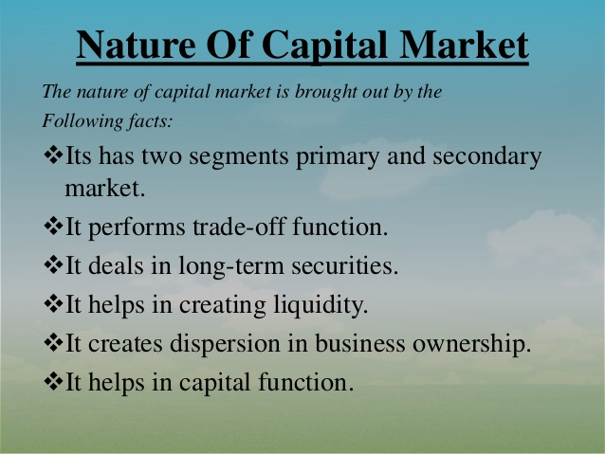

Slide 9
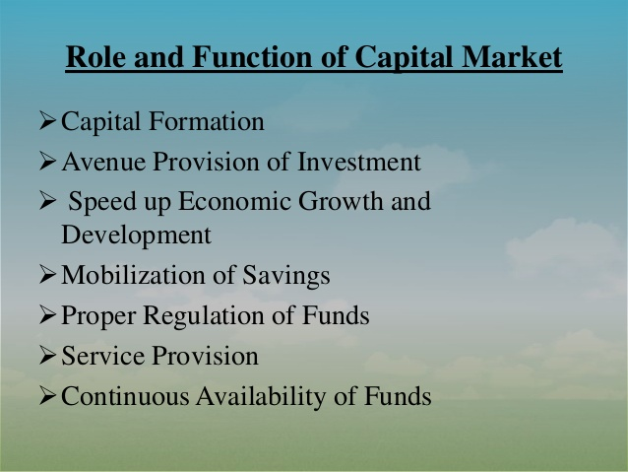

Slide 10
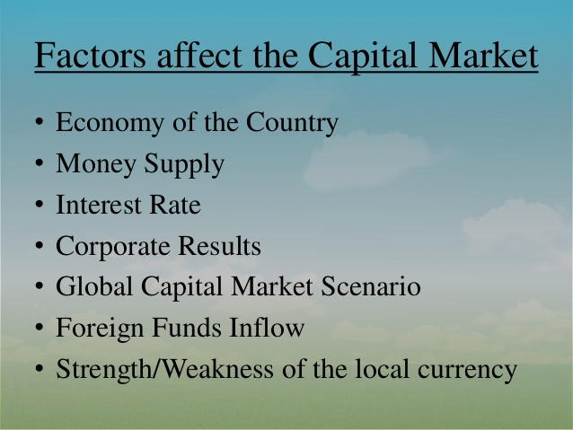

Slide 11
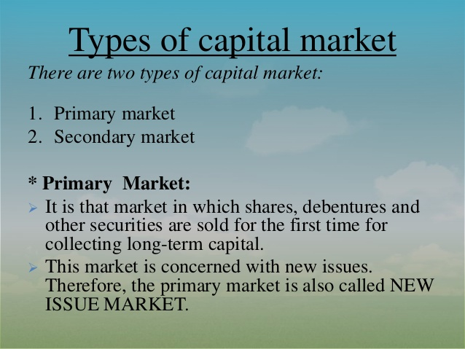

Slide 12
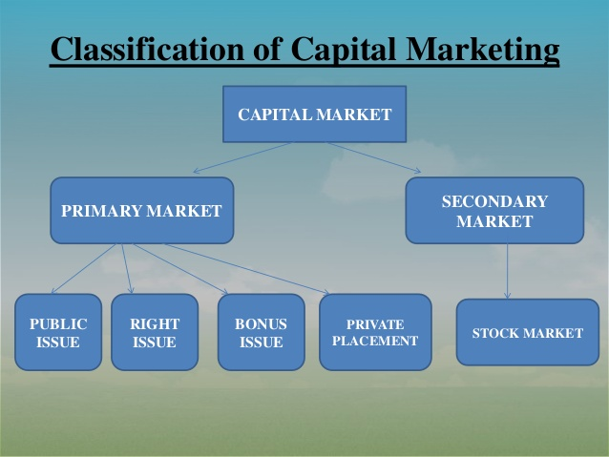

Slide 13
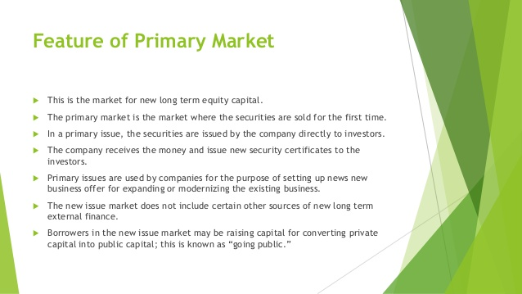

Slide 14


Slide 15
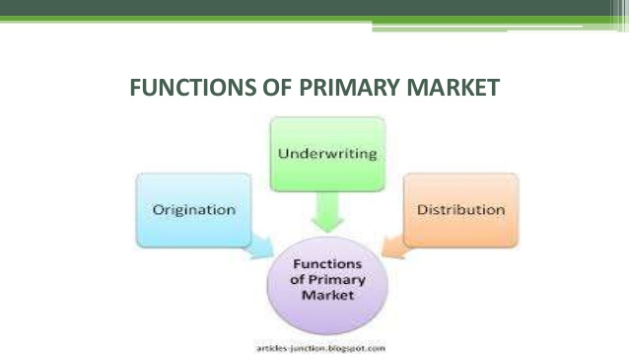

Slide 16
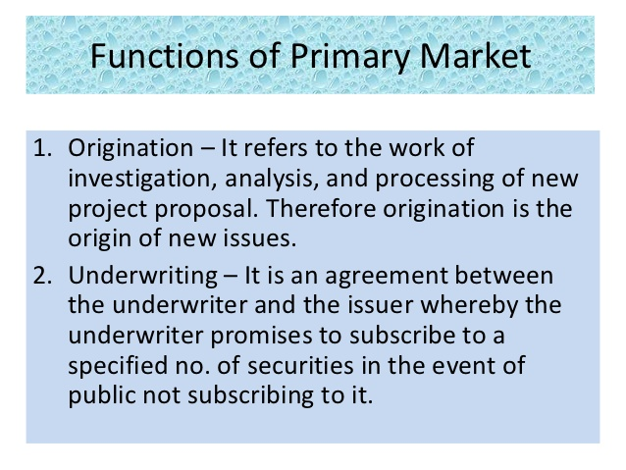

Slide 17
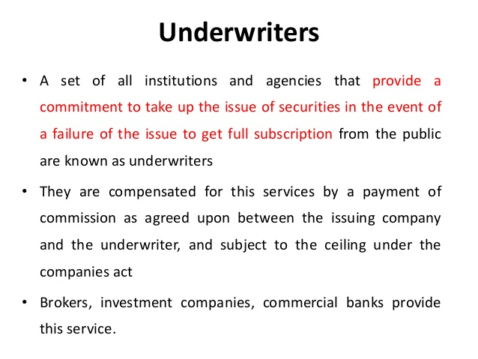

Slide 18
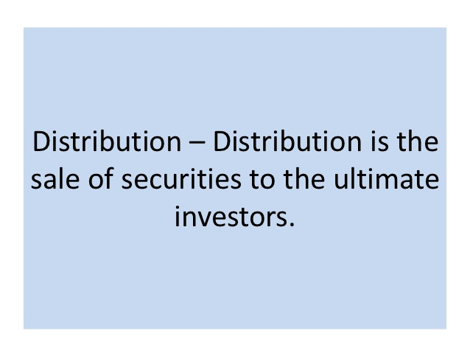

Slide 19
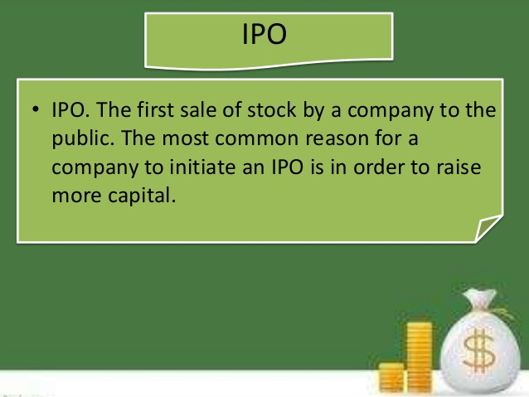

Slide 20
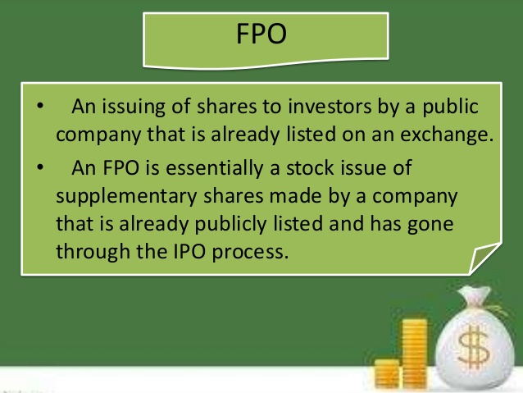

Slide 21
comparison
BASIS FOR COMPARISON | IPO | FPO
Meaning | Initial Public Offering (IPO) refers to an offer of securities made to the public for subscription, by the company. | Follow-on Public Offering (FPO) means an offer of securities for subscription to public, by an publicly traded enterprise.
What is it? | First public issue | Second or third public issue
Issuer | Unlisted Company | Listed Company
Objective | Raising capital through public investment. | Subsequent public investment.
Risk | High | Comparatively low

Slide 22


Slide 23


Slide 24
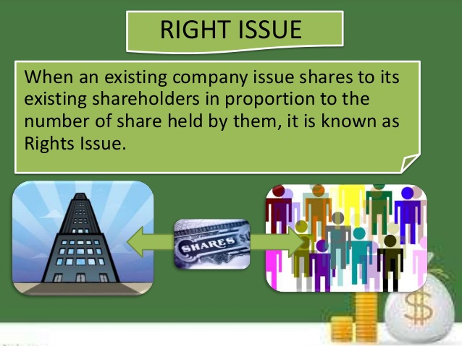

Slide 25
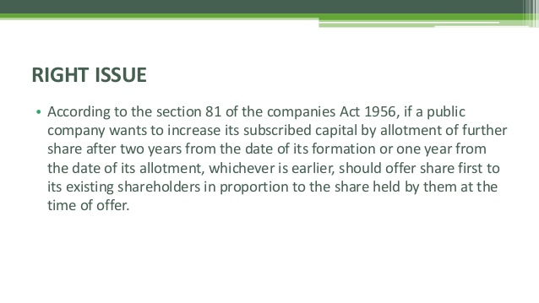

Slide 26
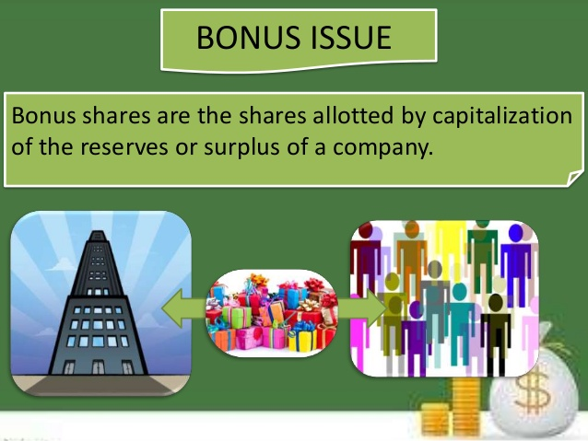

Slide 27
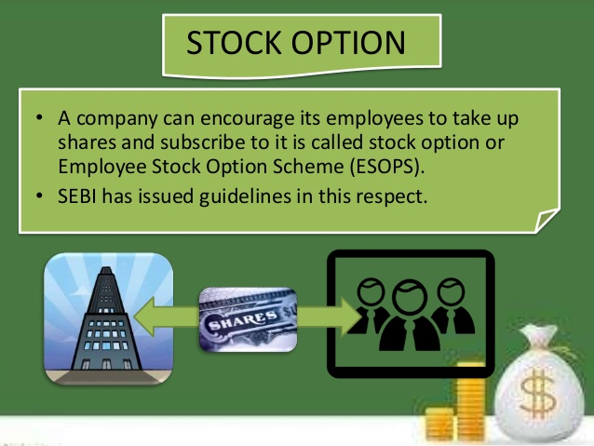

Slide 28
Primary Market Advantages
It provides opportunity for new investors to start new enterprises: Persons with technical know-how may resort to promote new ventures which are profit-oriented. The new issue market gives them an opportunity to materialize their ideas.
Existing companies will be in a position to expand their activities: When the existing companies find their products obsolete, they would like to venture into new areas of production for which they require additional capital. The new issue market helps them raise the required funds.

Slide 29
Promotion of partnership firm into Public Limited companies or merger of companies or facilitates buy-back of shares: When new ventures are started, a management may wish to have a control on the ownership and for this purpose, they would like to enter into a buy-back arrangement. By this arrangement, the shares will be issued to a group of persons (NRIs) for a specific period after which they will be bought back from out of the profits. This ensures the retention of ownership and prevents any change in management.

