Slide 1

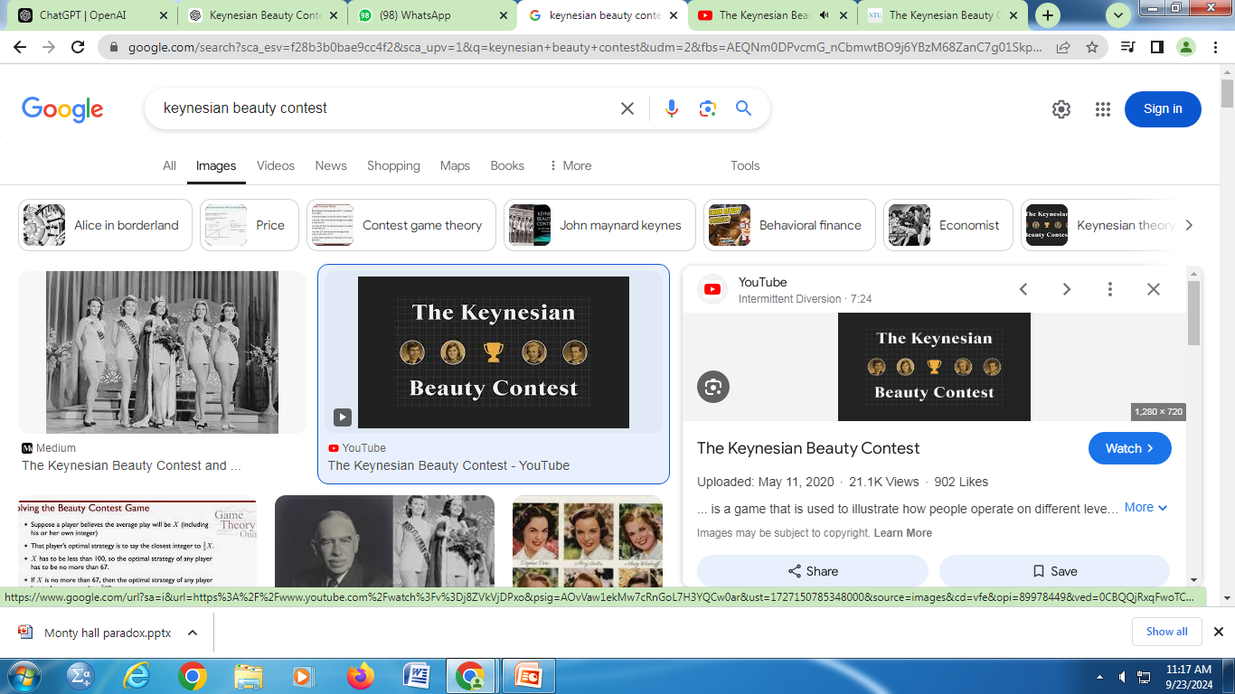
DR. F. WAHIDHA BEGUM
ASSISTANT PROFESSOR
JAMAL INSTITUTE OF MANAGEMENT
JAMAL MOPHAMED COLLEGE

Slide 2
Introduction to the Keynesian Beauty Contest
Introduced by John Maynard Keynes in 1936 to explain speculative behavior in financial markets.
Main Idea: Predicting what the average opinion of others will be, rather than basing decisions on intrinsic value.

Slide 3
A Keynesian beauty contest describes a beauty contest where judges are rewarded for selecting the most popular faces among all judges, rather than those they may personally find the most attractive.
Keynes described the action of rational agents in a market using an analogy based on a fictional newspaper contest, in which entrants are asked to choose the six most attractive faces from a hundred photographs. Those who picked the most popular faces are then eligible for a prize.
The concept was developed by John Maynard Keynes and introduced in Chapter 12 of his work, The General Theory of Employment, Interest and Money (1936), to explain price fluctuations in equity markets.

Slide 4
"It is not a case of choosing those [faces] that, to the best of one's judgment, are really the prettiest, nor even those that average opinion genuinely thinks the prettiest.
We have reached the third degree where we devote our intelligences to anticipating what average opinion expects the average opinion to be.
And there are some, I believe, who practice the fourth, fifth and higher degrees." (Keynes, General Theory of Employment, Interest and Money, 1936).

Slide 5
This idea is often applied in financial markets, whereby investors could profit more by buying whichever stocks they think other investors will buy, rather than the stocks that have fundamentally the best value, because when other people buy a stock, they bid up the price, allowing an earlier investor to cash out with a profit, regardless of whether the price increases are supported by its fundamentals.

Slide 6
Keynes believed that similar behavior was at work within the stock market.
This would have investors pricing shares not based on what they think an asset's fundamental value is, or even on what investors think other investors believe about the asset's value,
but on what they think other investors believe is the average opinion about the value of the asset, or even higher-order assessments.

Slide 7
Conclusion
The Beauty Contest Metaphor:
Participants pick the most attractive faces, not based on their preference but on what they think others will choose.
The contest shows that market participants focus on others' opinions rather than the fundamentals.

