Slide 1

Dr. F. WAHIDHA BEGUM
Assistant Professor
Jamal Institute of Management
Jamal Mohamed College

Slide 2
Efficient Market
Efficient Market mean a market in which share price follow an independent path.
Market Efficiency refers to the degree to which market prices reflect all available, relevant information. If markets are efficient, then all information is already incorporated into prices, and so there is no way to beat market because there are no undervalued or overvalued securities available.

Slide 3
What is Efficient Market Hypothesis?
The efficient market hypothesis originated in the 1960s and was published by economist Eugene Fama.
The efficient market hypothesis suggests that the current stock price fully reflects all the available information regarding a firm and hence it is impossible to beat the market using the same information.
you cannot beat the market by using the information that is already available to the public as the market has already incorporated and reflected all the relevant information which may impact the stock.

Slide 4
Key points
Stocks always trade at a fair price and reflects all the available information at a particular time.
It is impossible to purchase an undervalued stock and sell at an inflated price.
The only way an investor can possibly obtain a higher return than the market is by investing in riskier stocks.

Slide 5
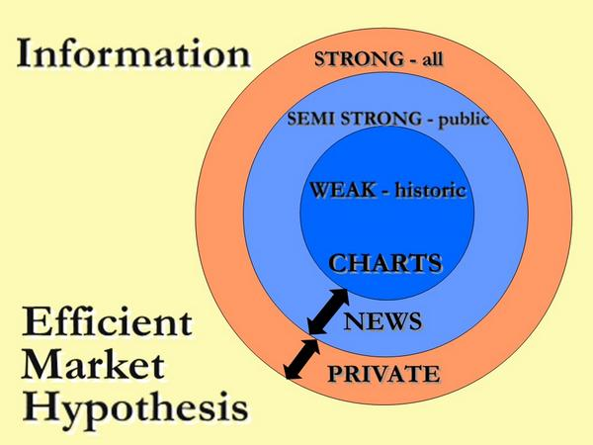
Forms of Efficient Markets

Slide 6
Advantages
Simplifying Investment Decisions: allows investors to trust that market prices are fair without needing to devote significant time and resources to researching individual stocks or assets.
EMH Promotes Market Confidence: integrate new information, giving investors greater trust

Slide 7
Stimulates Diversification
Reduces Impact of Market Bubble
Measuring Investment Performances
Discourages Insider Trading

Slide 8
Disadvantages
EMH Ignores Market Anomalies and Inefficiencies
Ignores behavioural Biases: EMH fails to take into account the influence of psychological biases
Unable to Explain Financial Crises and Bubbles
Underestimates the Value of Active Management
Discourages Fundamental Analysis
Imperfect Information Dissemination

Slide 9
Supply and Demand framework
Demand for an asset: Represents how much investors are willing to buy at a given price.
Supply of an asset: Represents how much of the asset is available for sale at a given price.
In an efficient market:
Price is determined by the balance between the supply and demand for an asset.
Any new information that impacts demand or supply is quickly incorporated into the asset's price.

Slide 10
Information and Price Adjustments (EMH) in the Supply-Demand Framework
New Information Affects Demand
When new positive information becomes available (e.g., an earnings beat or a breakthrough in technology), demand for the asset increases.
As demand increases, the price of the asset rises rapidly.
Conversely, if negative information (e.g., a profit warning) is released, demand falls, and prices decrease.
b. New Information Affects Supply
An increase in price may induce some current holders to sell their assets, increasing the supply temporarily.
As prices fall in reaction to negative news, holders may be less inclined to sell, reducing supply at lower prices.
Result in an Efficient Market:
Prices quickly adjust to reflect the new balance of supply and demand.
The efficiency of this adjustment process depends on how rapidly market participants incorporate and act on the new information.

Slide 11
Market Efficiency and Price Discovery
Price discovery is the process by which markets determine the price of an asset. In an efficient market:
Prices are always at an equilibrium point where supply equals demand.
New information causes shifts in demand and/or supply, but prices adjust so quickly that mispricing is minimal.

Slide 12
The EMH aligns with the classical supply and demand framework by suggesting that prices reflect all available information at any given time.
In an efficient market, the forces of supply and demand immediately adjust to any new information, ensuring that prices are always at equilibrium.
While behavioral biases may occasionally create short-term inefficiencies, EMH posits that these are corrected by rational market forces over time.
Thus, from a supply and demand perspective, EMH maintains that prices in financial markets are always optimal, based on the available information, preventing consistent opportunities for outperformance.

