Slide 1
Order Management & Order Fulfilment
Armaan Salik J
Assistant Professor,
Jamal Institute of Management

Slide 2
Order Management
Order management covers the full range of activities involved in receiving, handling, and monitoring customer orders from creation through delivery. It includes a variety of tasks, including order taking, inventory control, payment processing, and customer support. Order management’s key objectives are to improve customer happiness, expedite the order processing workflow, and keep accurate transaction records.

Slide 3
Key components of Order Management
Order Capture: This involves fulfiling customer orders through a variety of channels, including websites, mobile applications, and physical storefronts.
Inventory Management: Ensuring real-time stock visibility and inventory optimisation to avoid stockouts or overstock conditions.
Payment Processing: Utilising effective and secure payment mechanisms to carry out transactions successfully.
Customer Service: Answering customer questions, altering orders, and fixing order-related problems.

Slide 4
Importance of Order Management
Order Management System (OMS) Impact:
  Affects almost every aspect of supply chain operations.
  Involves multiple partners (distributors, assembly/packaging companies, suppliers).
  Risk of losing control over orders without proper systems.
Challenges:
  Manual methods are expensive and prone to errors.
  Necessitates automation to reduce mistakes, save costs, and boost revenue.
Customer Experience:
  Directly influences how customers perceive a brand.
  Customers expect seamless omnichannel experiences (e.g., online orders, call centers, emails, returns).
Opportunities for Growth:
  Every customer touchpoint is an opportunity for excellent service, retention, and increased revenue.
  Omnichannel journeys create potential for up-selling and cross-selling.

Slide 5
Order Fulfilment
The choosing, packaging, and shipping of orders to clients is referred to as order fulfilment, which is a part of order management. The operational part of the order processing cycle is what guarantees correct and timely delivery of the physical goods.

Slide 6
Importance of Order Fulfilment
Customer Expectations:
  Two-day or next-day shipping is now standard.
  Delayed or inconsistent delivery can harm the business and financial performance.
Impact of Bad Delivery:
  43% of customers won’t shop with a merchant for at least a month after a poor delivery experience.
  38% will stop shopping with that merchant altogether.
Influence of Delivery Options:
  Delivery choices directly affect customer shopping preferences.
  Customers seek options that align with their budget and time constraints (fast or delayed delivery).
Risk for Businesses:
  Companies without attractive delivery options risk losing customers.
  58% of customers choose one business over another due to better delivery alternatives.
  45% abandon carts due to inadequate delivery options.

Slide 7
Key components of Order Fulfilment
Order Picking: Obtaining the goods from the stock shelves in the warehouse to fulfil client orders.
Order Packing: Packing the things for transportation in a safe and secure manner while taking their fragility and size into consideration.
Shipping: Selecting the best shipping options and carriers to ensure prompt arrival to the customer’s location.
Order Tracking: Provide consumers with tracking details so they may keep track of the progress of their order until it gets to its destination.

Slide 8
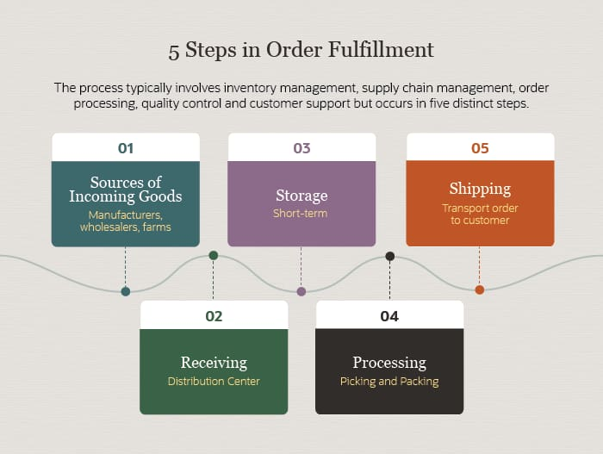

Slide 9
 | Order Management | Order Fulfillment
Definition | Overseeing and coordinating the end-to-end lifecycle of an order, starting from its initiation to its eventual delivery or potential return. | Specifically refers to the logistical processes, from picking items in a warehouse to their delivery to the customer's location.
Core Components | Order capture across multiple channels (online, offline, phone, etc.) Payment processing & verification Order tracking & updates Inventory visibility & synchronization Handling returns, exchanges & customer queries | Product retrieval (picking) from inventory Product packaging with necessary documentation Shipping and handling logistics Warehousing and storage optimization Managing stock levels and restocking

Slide 10
 | Order Management | Order Fulfillment
Primary Objective | To streamline the administrative aspects of sales, enhancing customer experience and ensuring efficient order processing. | To physically get the right products to the end customer in a timely and efficient manner while minimizing errors.
Tools & Technologies | Order Management Systems (OMS) that integrate with sales channels CRM for customer data management ERP for broader business process integration Payment gateways & fraud detection systems | Warehouse Management Systems (WMS) to optimize storage and retrieva Barcode scanners and RFID tags for inventory tracking Robotics and automated systems for large-scale operations Transportation Management Systems (TMS) for shipping logistics

Slide 11
Order Management | Order Fulfillment
Challenges | Integrating multiple sales channels Real-time inventory synchronization Addressing customer issues promptly Preventing order fraud | Efficiently storing diverse products Speedy picking and packing Managing shipping costs Handling returns logistics
Impact on Customer Experience | Directly affects how customers perceive the brand based on their ordering experience, ease of payment, and communication frequency. | Impacts the customer's satisfaction based on delivery speed, product condition upon arrival, and accuracy of the order.

