Slide 1
INTRODUCTION TO BANKING
Dr.M.A.SHAKILA BANU
ASSOCIATE PROFESSOR
JAMAL INSTITUTE OF MANAGEMENT
JAMAL MOHAMED COLLEGE

Slide 2
Meaning of Banking
Banking refers to the activities and services provided by financial institutions, primarily banks, that involve managing money and other financial assets. The core functions of banking typically include:
Accepting Deposits: Banks accept money from customers in the form of deposits, which can be savings accounts, current accounts, or fixed deposits.
Lending Money: Banks lend money to individuals, businesses, and governments at an interest rate, thereby providing credit to fuel economic activities.
Facilitating Payments: Banks facilitate payments through various channels like cheques, electronic transfers, credit/debit cards, and online banking.

Slide 3
Evolution of Banking
The evolution of banking can be understood in stages from ancient times to the present.
1. Early Forms of Banking (Ancient Civilizations)
Mesopotamia (c. 2000 BCE): One of the first forms of banking emerged in ancient Sumer (modern-day Iraq), where temples and palaces acted as financial centers, storing wealth and making loans.
Ancient Greece and Rome (500 BCE - 400 CE): Banking activities included lending, deposit-taking, and currency exchange. Moneylenders or "argentarii" were popular in Rome, who also engaged in foreign exchange.

Slide 4
Medieval Banking (5th to 15th Century)
Italy – The Birth of Modern Banking (12th Century): The rise of banking families like the Medici in Florence laid the foundation for modern banking. They created early forms of bills of exchange, promissory notes, and letters of credit.
The Role of Guilds: In medieval Europe, trading guilds played a significant role in facilitating credit and trade financing.
Banks in the Islamic World: Islamic banking evolved in the medieval period, based on principles of profit-sharing and risk-sharing instead of charging interest (usury), as per Sharia law.

Slide 5
3.Renaissance and Early Modern Banking (16th to 18th Century)
The Rise of Joint-Stock Banks (17th Century): This period saw the rise of joint-stock banks, where investors pooled resources to finance projects and engage in foreign trade. The Bank of England, founded in 1694, is one of the earliest examples of a central bank.
Development of Bills of Exchange and Credit: The growth of international trade in Europe led to the development of bills of exchange, which facilitated international trade by allowing merchants to settle debts without physical money.
4. Industrial Revolution (18th to 19th Century)
Commercial Banks as Key Players in Industrialization: As the Industrial Revolution gathered pace, the demand for capital increased. Banks played a crucial role in financing new industrial ventures, infrastructure development, and the growth of cities.
Establishment of Central Banks: Many countries began to establish central banks to regulate currency, manage inflation, and ensure economic stability. The Federal Reserve (1913) in the U.S. is one of the most prominent examples.

Slide 6
5. 20th Century and the Modern Banking System
Technological Innovations: The 20th century saw significant technological advancements in banking, including the introduction of ATMs, electronic funds transfer (EFT), and online banking.
Globalization and Digital Banking: The global expansion of financial markets and advances in technology led to the rise of online banking, digital payments, and the globalization of financial transactions.
Deregulation and Financial Crises: In the latter part of the 20th century, deregulation of banking laws and financial markets occurred in many countries. However, this also led to financial crises such as the 2007-2008 global financial crisis.
6. 21st Century: Digital Banking & Fintech
Rise of Digital Banking: Online and mobile banking became mainstream, with customers able to access banking services from anywhere at any time. Neobanks (banks without physical branches) have gained popularity.
Fintech and Cryptocurrencies: The financial technology (fintech) industry and digital currencies like Bitcoin have radically transformed how people manage money, make payments, and invest.
Artificial Intelligence and Blockchain: AI is now being used for customer service (chatbots), credit scoring, and fraud detection. Blockchain technology is revolutionizing payments and banking transactions by offering decentralized, secure, and transparent systems.

Slide 7
Challenges and Trends in Modern Banking
Cybersecurity Threats: With increasing reliance on digital banking, cybersecurity has become a major concern. Banks face the risk of hacking, data breaches, and fraud.
Regulation and Compliance: Banks must comply with evolving regulatory frameworks aimed at ensuring financial stability, protecting consumers, and preventing money laundering.
Sustainability and Ethical Banking: There is growing focus on green banking, ethical investments, and corporate social responsibility in banking activities.
AI and Automation: The use of artificial intelligence and automation in credit assessment, risk management, and customer service is transforming the banking sector.

Slide 18
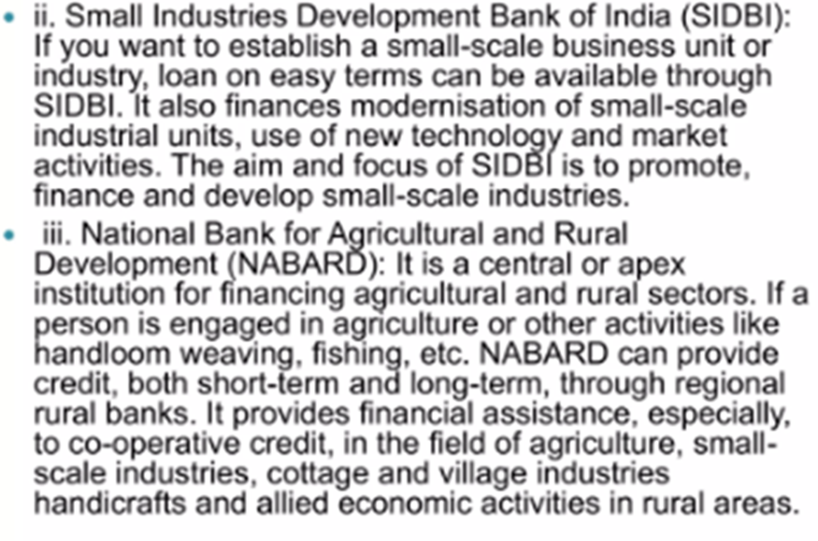

Slide 23
