Slide 1
Concept of Minimum Wage, Living Wage, and Fair Wage

Slide 2
Overview
Wages are a fundamental aspect of labor economics and play a crucial role in determining the standard of living for workers.
Governments, labor organizations, and businesses implement wage policies to balance fair worker compensation and economic sustainability.
Three major wage concepts are widely discussed:
  Minimum Wage – The lowest legally mandated wage an employer can pay an employee.
  Living Wage – A wage that allows workers to afford basic necessities and maintain a decent quality of life.
  Fair Wage – A wage that considers worker contribution, industry standards, and ethical compensation.

Slide 3
Minimum Wage – Definition and Purpose
Definition
Minimum Wage is the legally mandated lowest amount an employer must pay an employee for work performed.
It is typically set by government authorities and varies by country, industry, and sometimes region.
Purpose
To protect workers from exploitation and ensure they receive a basic level of income.
To provide a baseline standard of living, though not necessarily sufficient for all essential needs.
To reduce income inequality and promote economic stability.

Slide 4
Key Characteristics
Fixed by law and government regulation.
Adjusted periodically based on inflation and economic conditions.
Different countries have different minimum wage policies—some apply a national wage, while others vary by industry or state.
Example of Minimum Wages in Different Countries
United States: Federal minimum wage of $7.25 per hour, but states can set higher wages.
United Kingdom: £11.44 per hour (as of April 2024) for workers aged 23 and over.
India: Minimum wage varies by state and occupation, ranging from ₹176 to ₹500 per day.

Slide 5
Minimum Wage – Pros and Cons
Pros (Advantages)
✅ Protects low-income workers from exploitation.
✅ Helps reduce poverty and ensures a basic level of income.
✅ Boosts worker morale and productivity.
✅ Reduces reliance on social welfare programs.
Cons (Disadvantages)
❌ Can lead to higher unemployment if businesses cannot afford to pay workers.
❌ May cause businesses to cut hours or reduce benefits to compensate for wage increases.
❌ Some minimum wages do not align with the cost of living, making them insufficient for workers.
❌ Encourages informal employment, where businesses may avoid regulations.

Slide 6
Living Wage – Definition and Components
Definition
A Living Wage is a wage that enables workers to afford a decent standard of living, including essential expenses like:
  Housing
  Food
  Healthcare
  Education
  Transportation
Unlike the minimum wage, which is legally enforced, the living wage is often a benchmark suggested by social and economic researchers.

Slide 7
Components of a Living Wage
📌 Housing Costs – Rent or mortgage payments.
📌 Food Costs – Nutritious food and household groceries.
📌 Healthcare Costs – Medical expenses, insurance, and emergency care.
📌 Transportation Costs – Public or private transport expenses.
📌 Childcare and Education – School fees, childcare, and tuition.
📌 Savings & Miscellaneous – Emergency savings, leisure, and unforeseen expenses.

Slide 8
Living Wage – Importance and Implications
Importance
✅ Ensures workers can meet their basic needs and live with dignity.
✅ Reduces income inequality and improves economic stability.
✅ Enhances employee motivation and reduces turnover rates.
✅ Strengthens local economies by increasing purchasing power.
Implications for Businesses & Government
Companies that offer a living wage often experience higher employee retention and better job satisfaction.
Governments may use tax incentives to encourage businesses to adopt living wage policies.
Helps reduce the burden on social welfare programs by enabling workers to sustain themselves.
Example of Living Wage Policies
United Kingdom: The Real Living Wage (£12.00 per hour outside London, £13.15 in London).
Canada: Living wage varies by province, e.g., CAD 20 per hour in Vancouver.

Slide 9
Fair Wage – Definition and Ethical Considerations
A Fair Wage is a wage that is ethically justified and takes into account:
  Worker productivity and contribution.
  Industry wage standards.
  Employer profitability and ability to pay.
  Economic and social fairness.
Fair Wage vs. Minimum & Living Wage
A minimum wage is the lowest legal pay.
A living wage ensures basic living costs are covered.
A fair wage considers equity, fairness, and market conditions.
Ethical Considerations
Ensuring equal pay for equal work.
Promoting worker dignity and recognition.
Balancing employer financial capability with fair compensation.

Slide 10
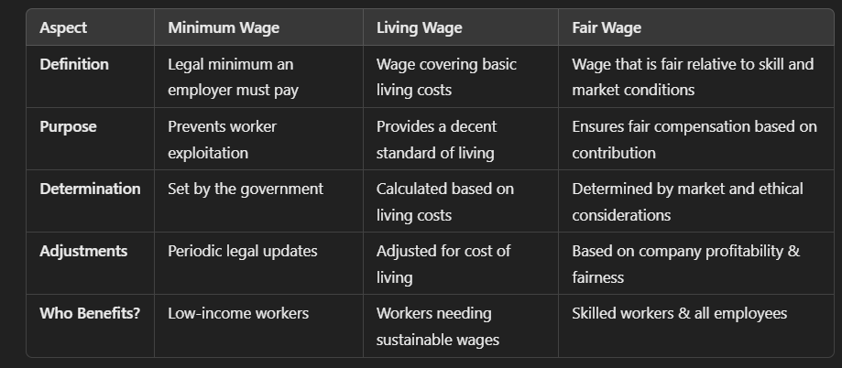
Comparison of Minimum, Living, and Fair Wages

Slide 11
Challenges and Future Directions
Challenges
Inflation & Wage Adjustments: Rising costs may make wages outdated.
Employer Compliance: Some companies avoid wage policies to cut costs.
Global Wage Disparities: Developing nations struggle with wage fairness.
Future Directions
Stronger Wage Policies: Governments and organizations should revise wages frequently.
Corporate Responsibility: Businesses should promote fair and living wages.
Technological Solutions: Data analytics can help determine fair wages based on industry trends

