Slide 1
Chief diversity officer
Armaan Salik.J
Assistant Professor,
Jamal Institute of Management,
Jamal Mohamed College.

Slide 2
Introduction
A Chief diversity officer architects a business’s diversity, equity, and inclusion (DEI) programs. This executive creates strategies to create an environment for diverse hiring at the organization and diversity training programs for workers.
Chief diversity officers are upper-level managers dedicated to inclusion and equality at companies and educational institutions.

Slide 3
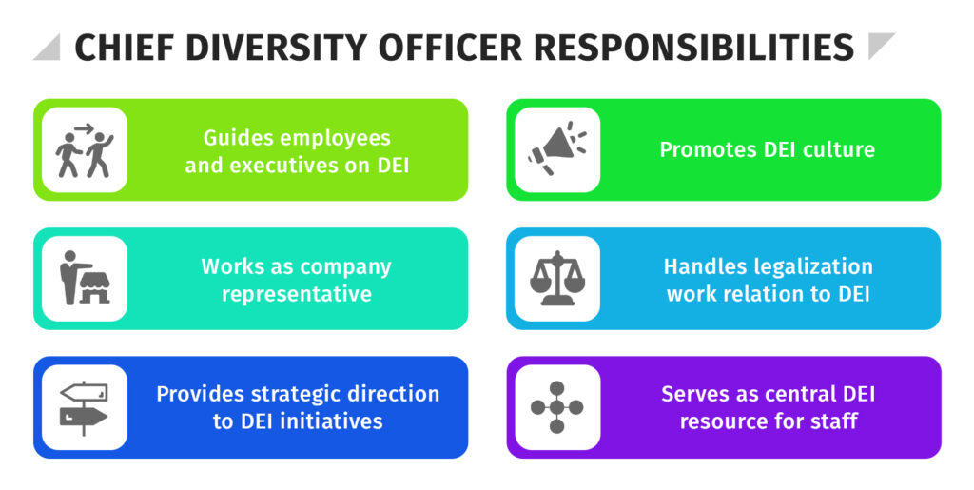

Slide 4
Key Responsibilities
Strategic Leadership: Develop, execute, and evaluate DEI strategies that align with corporate objectives, ensuring DEI is embedded in all facets of the organization.
Policy Development: Create policies and practices that support a diverse, equitable, and inclusive work environment, focusing on recruitment, hiring, retention, and advancement.
Employee Engagement: Collaborate with HR and internal stakeholders to foster an inclusive culture through employee resource groups, mentorship programs, and company-wide DEI initiatives.
Education and Training: Design and implement training programs to promote awareness, reduce unconscious bias, and equip employees with tools for inclusive behaviors.
Data-Driven Approach: Monitor DEI metrics, analyze trends, and use data to refine DEI strategies and measure initiative effectiveness.
Community Engagement: Liaison with external partners and community organizations to promote diversity and inclusion outside the company and strengthen our public commitment.
Compliance and Advocacy: Ensure compliance with DEI-related regulations and advocate for policy changes that enhance DEI practices internally and externally.

Slide 5
Qualifications
Education: A bachelor’s degree is required; an advanced degree in human resources, organizational development, DEI, or a related field is preferred.
Experience: 8-10 years of experience in DEI, HR, or related field with proven success leading diversity and inclusion initiatives.
Leadership Skills: Demonstrated ability to lead, inspire, and influence at all levels of the organization.
Analytical Skills: Strong understanding of DEI metrics and KPIs and experience leveraging data to drive strategy and accountability.
Communication Skills: Exceptional written and verbal communication skills, with the ability to engage, influence, and inspire stakeholders.
Commitment to DEI: Deep passion for fostering a diverse, equitable, and inclusive workplace and a strong understanding of DEI best practices

Slide 6
Chief diversity officer skills
Leadership: As executive-level employees, chief diversity officers lead, guide and inform teams across all departments and motivate staff to work together to achieve shared goals.
Public speaking: Chief diversity officers might give presentations and speeches to employees, stakeholders and external organizations and agencies.
Legal knowledge: Chief diversity officers should understand local and national laws, codes and regulations associated with inclusion and equality.
Problem-solving: These executives should have good conflict management skills and be able to find fair solutions to workplace issues.
Empathy: Chief diversity officers should be able to understand and respect people from a variety of backgrounds and experiences.
Communication: Chief diversity officers should have strong written and verbal communication skills for writing reports and delivering effective messages to employees and audiences.
Budgeting: These officers develop and manage budgets for diversity initiatives and activities.
Multitasking: Chief diversity officers should have the time management and organizational skills to simultaneously oversee multiple projects and departments.

