Slide 1
DECISION TREE
Dr.M.A.SHAKILA BANU
ASSOCIATE PROFESSOR
JAMAL INSTITUTE OF MANAGEMENT
JAMAL MOHAMED COLLEGE

Slide 2
Definition: A decision tree is a predictive model used to go from observations about an item to conclusions about the item’s target value
Definition: A graphical representation of decisions and their possible consequences
Structure: It consists of nodes , branches , and leaf nodes
DECISION TREE

Slide 3
Purpose
To support decision-making by visualizing options and their potential outcomes

Slide 4
Structure of a Decision Tree
Nodes
Decision Nodes: Points where decisions are made
Chance Nodes: Points where outcomes are uncertain
End Nodes: Terminal points showing outcomes
Branches: Connect nodes, representing different choices or outcomes

Slide 5
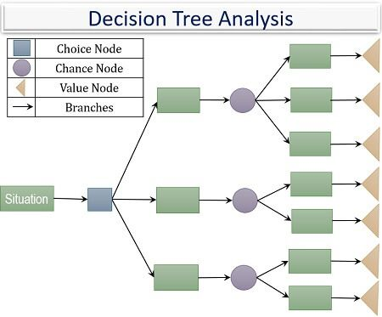
How Decision Trees Work
Process
Start at the root node
Move through decision and chance nodes
Follow branches based on decisions and outcomes
Reach end nodes with final outcomes

Slide 6
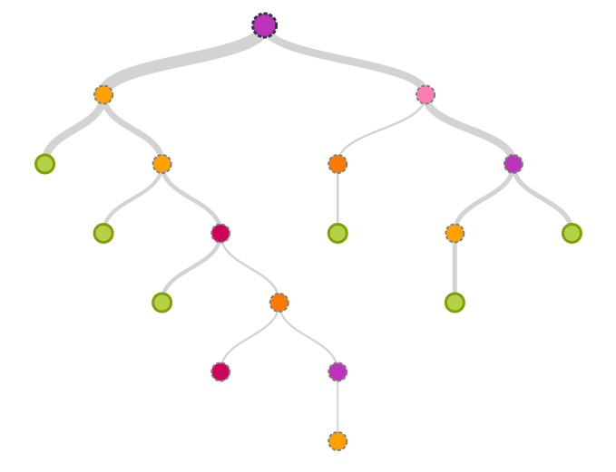
Visualization of a Decision Tree
Example Graph
A simple decision tree chart that shows how a decision tree might classify data, such as predicting whether a customer will purchase a product based on their age and income

Slide 7
Types of Decision Trees
Classification Trees: Used for categorizing data
Regression Trees: Used for predicting continuous values

Slide 8
Advantages of Decision Trees in Business Analytics
Interpretability: Easy to understand and interpret as they mimic human decision-making processes
Versatility: Can handle both numerical and categorical data
No Assumptions About Data: Decision trees do not require the data to follow any specific distribution
Visual Appeal: Easy to interpret and understand
Versatility: Handles both categorical and numerical data
Clear Decision Rules: Provides straightforward rules for decision-making

Slide 9
Limitations of Decision Trees
Overfitting: Can create overly complex trees that do not generalize well to new data
Bias: Can be biased towards the dominant class if the data is imbalanced
Instability: Small changes in the data can result in significantly different tree structures
Complexity: Trees can become unwieldy with many levels

Slide 10
Building a Decision Tree
Steps
Data Collection: Gather relevant data
Feature Selection: Identify important features
Tree Construction: Use algorithms to build the tree
Validation: Test the tree to ensure accuracy

Slide 11
Applications in Business Analytics
Customer Segmentation: Classifying customers into different groups for targeted marketing
Credit Scoring: Assessing the creditworthiness of a borrower
Churn Prediction: Identifying customers likely to leave a service
Fraud Detection: Detecting potentially fraudulent transactions by classifying transaction patterns

Slide 12
Applications in Business Analytics
Risk Assessment: Evaluate the risk of potential business decisions
Sales Forecasting: Predict future sales based on historical data

