Slide 1
Chief Happiness Officer
Armaan Salik.J
Assistant Professor,
Jamal Institute of Management,
Jamal Mohamed College.
Trichy

Slide 2
Meaning
Chief happiness officers are typically senior managers within an HR department who take a holistic approach to people’s well-being and happiness.
CHO usually operates in a human resource (HR) department and provides support and consultation services to managers and employees.

Slide 3
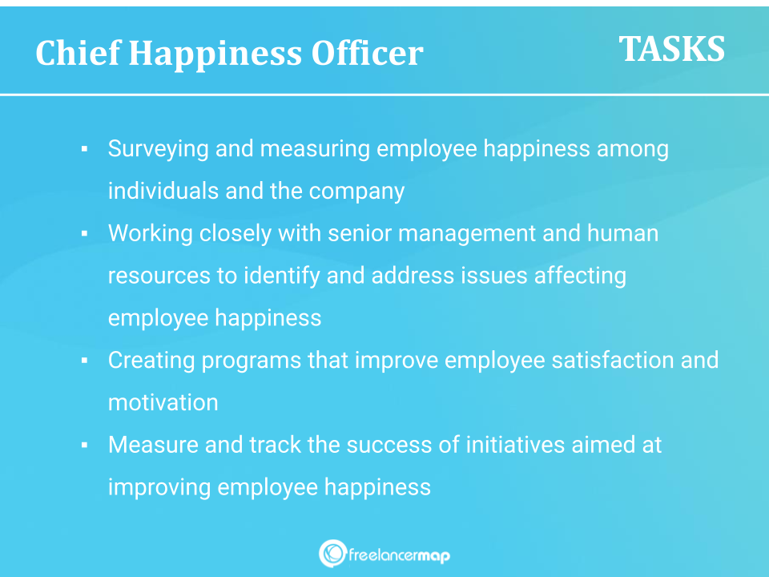
Responsibilities

Slide 4
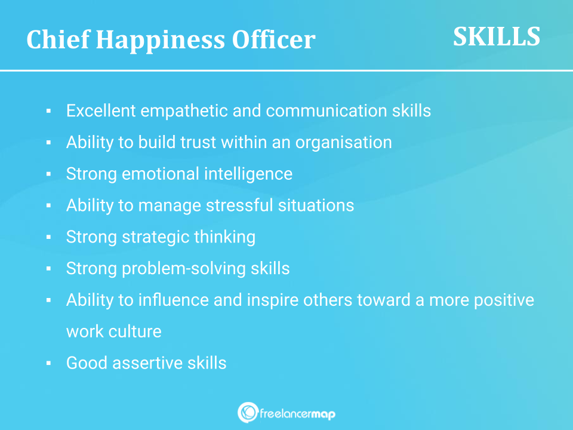
Skills Required

Slide 5
Job Description of a CHO
We are looking for a Chief Happiness Officer who is passionate about and understands human resources. The perfect candidate represents the wishes of our employees and constantly ensures a positive working atmosphere.
Responsibilities:
– Act as a link between the workforce and management
– Survey and measure employee happiness among individuals and the company
– Ensure a fundamentally positive working atmosphere
– Create programs that improve employee satisfaction and motivation
– Measure and track the success of initiatives aimed at improving employee happiness
– Organize workshops and team events
Skills:
– Excellent social skills
– Good assertive skills
– Strong presentation and communication skills
– Ability to build trust within an organisation
– Strong emotional intelligence
– Ability to manage stressful situations
– Strong strategic thinking
Preferred qualifications:
– Background in HR
– Ideally completed further training to become a CHO

Slide 6
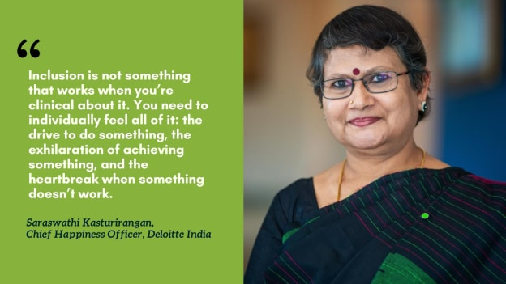
https://www.peoplematters.in/article/diversity/leading-with-heart-deloittes-chief-happiness-officer-on-strengthening-workplace-inclusivity-40527

