Slide 1
Strategic Management Models: GE-McKinsey Matrix, M/8 Model & McKinsey's 7S Framework

Slide 2
Introduction to Strategic Management Models
Strategic models help businesses make decisions on investment, resource allocation, and organizational development.
These models provide frameworks to analyze industry position, internal capabilities, and business strategies.

Slide 3
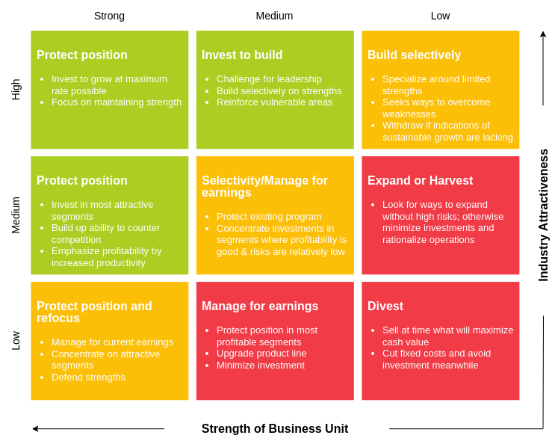
GE-McKinsey Matrix
Developed by General Electric and McKinsey & Company.
Helps businesses analyze and prioritize strategic business units (SBUs) based on Industry Attractiveness and Business Strength.

Slide 4
Components of the GE-McKinsey Matrix
Industry Attractiveness: Market growth, profitability, competition intensity, etc.
Business Unit Strength: Market share, brand reputation, cost efficiency, etc.
3x3 matrix categorizing businesses into:
  Grow/Invest
  Selective Investment
  Harvest/Divest

Slide 5
Strategic Implications
Grow/Invest: High attractiveness and high strength – focus on expansion.
Selective Investment: Medium attractiveness – analyze further before investing.
Harvest/Divest: Low attractiveness – consider withdrawing or repositioning.

Slide 6
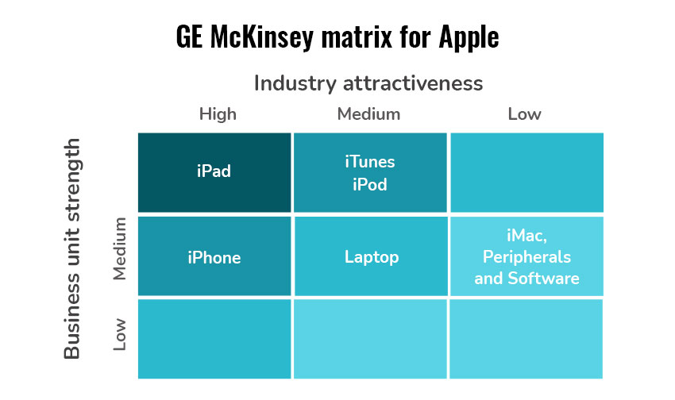
Apple’s GE-McKinsey Matrix Example
Industry Attractiveness
High: Smartphones (iPhone) & Tablets (iPad)
  Growing demand, strong profitability, clear product differentiation.
Medium: Laptops, iTunes, iPod
  Moderate growth rates, rising competition in online music/apps & laptops.
Low/Uncertain: iMac
  Slow growth in desktop market; lower market share.

Slide 7
Business Unit Strength
Strong: iPhone, iPad, iTunes, iPod
  High market share (iPhone, iPad); pioneering music platform (iTunes & iPod).
Medium: iMac
  Some loyal customers but limited overall market share.
Lower: Laptops (facing intense competition and slower growth).

Slide 8
Strategic Implications
Invest/Grow: iPhone, iPad, iTunes, iPod
  Leverage strong market positions and high demand.
Hold: iMac
  Market is uncertain; consider boosting sales through advertising, loyalty programs.
Monitor/Selective Investment: Laptops
  Competitive market, lower growth rate, invest selectively.

Slide 9
Outcome
Focus on the most profitable (high attractiveness + strong strength) products to maximize returns.
Use the GE-McKinsey framework to guide resource allocation and future growth strategies.

Slide 10
M/8 Model
Developed by McKinsey to assess strategic options for businesses.
Focuses on 8 critical dimensions of business strategy.

Slide 11
Key Components of the M/8 Model
Market Position
Products & Services
Customer Base
Competitive Environment
Financial Performance
Growth Potential
Brand Strength
Operational Efficiency
Application of M/8 Model
Helps companies decide on diversification, market entry, and competitive strategies.
Example: Tesla evaluating its electric vehicle product lines based on these factors.

Slide 12
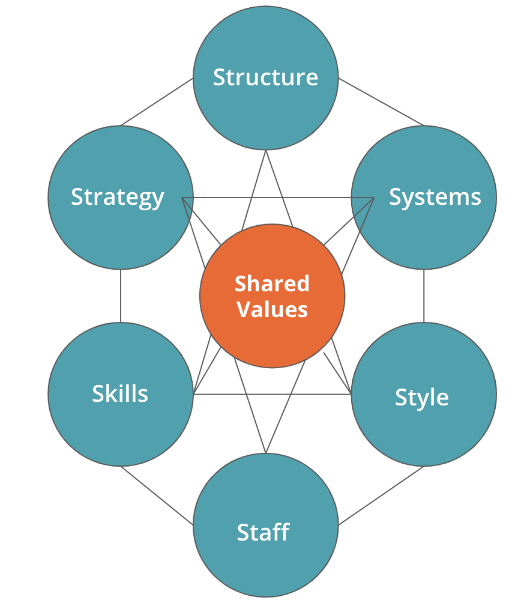
McKinsey’s 7S Framework
Developed to analyze organizational effectiveness and alignment.
Helps in change management, restructuring, and performance improvement.

Slide 13
Elements of the 7S Framework
Strategy: Company’s plan to achieve a competitive edge.
Structure: Organizational hierarchy and reporting system.
Systems: Processes and workflows governing operations.
Shared Values: Core company values influencing culture.
Skills: Employee capabilities and competencies.
Style: Leadership approach and management style.
Staff: Human resource policies, talent acquisition, and retention.

Slide 14
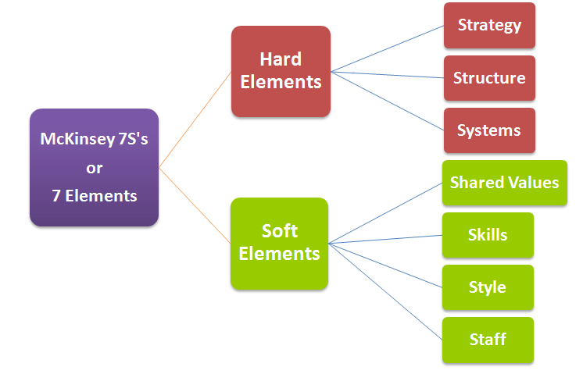
Hard vs. Soft Elements
Hard Elements: Strategy, Structure, Systems (Tangible and measurable).
Soft Elements: Shared Values, Skills, Style, Staff (Intangible, culture-driven).

Slide 15
Conclusion
GE-McKinsey Matrix helps in investment decisions for business units.
M/8 Model evaluates key business dimensions for strategy formulation.
McKinsey’s 7S Framework aligns organizational components for effectiveness.
Application of these models enhances strategic decision-making in businesses.

