Slide 1
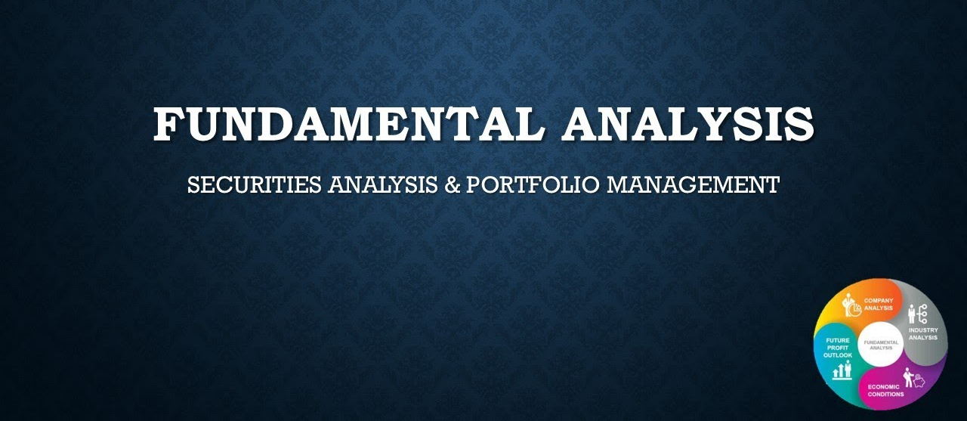
DR. F. WAHIDHA BEGUM
ASSISTANT PROFESSOR
JAMAL INSTITUTE OF MANAGEMENT
JAMAL MOPHAMED COLLEGE

Slide 2
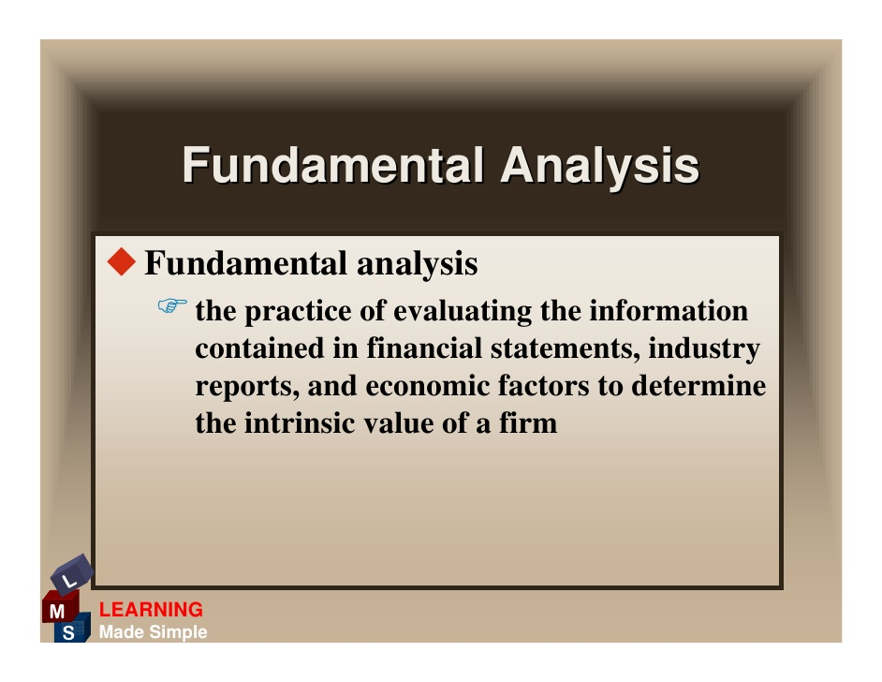

Slide 3
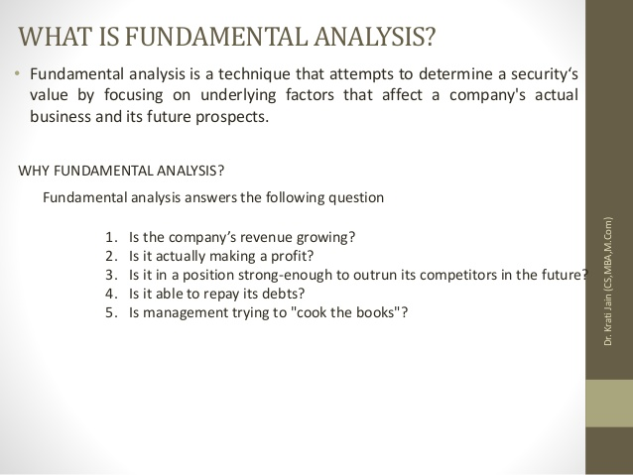

Slide 4
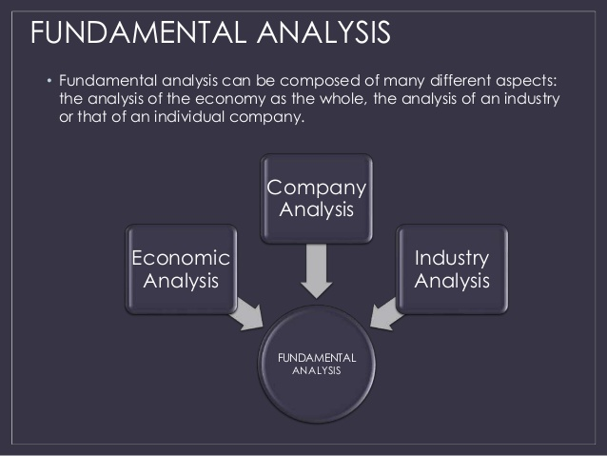
s

Slide 5
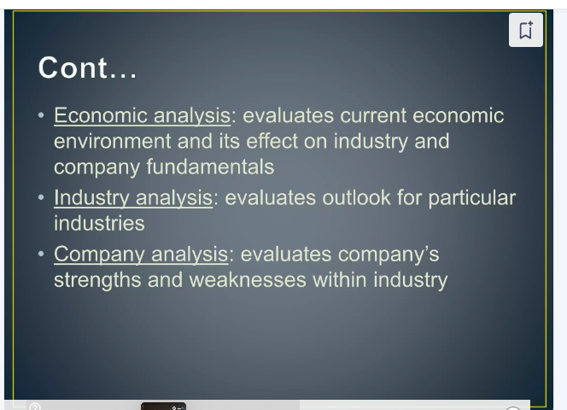

Slide 6


Slide 7
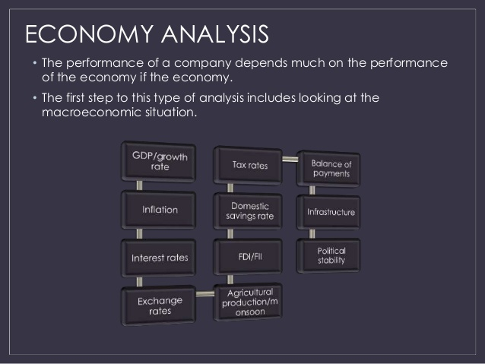

Slide 8
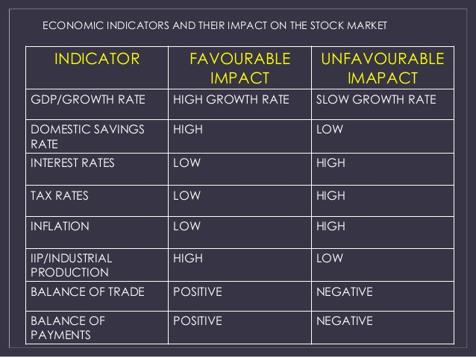

Slide 9
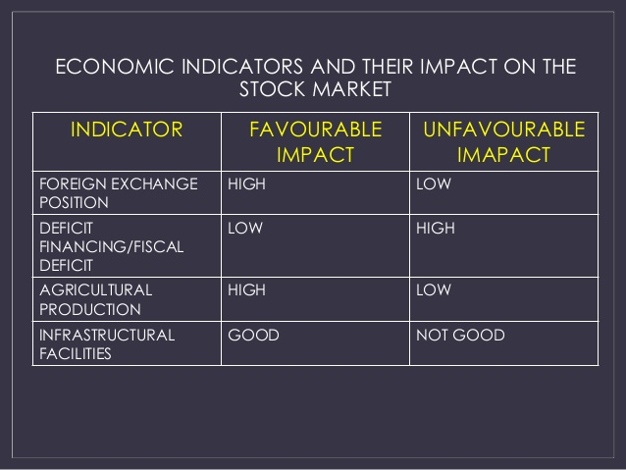

Slide 10
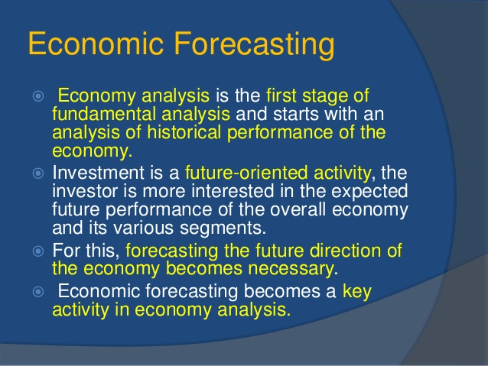

Slide 11
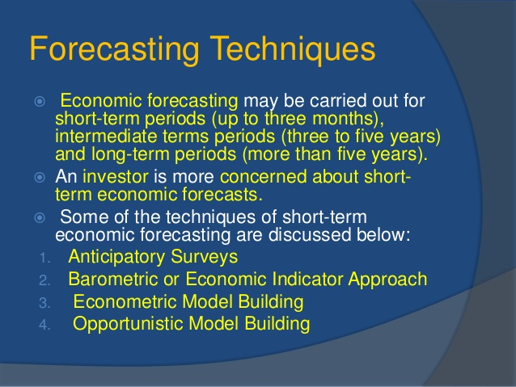

Slide 12
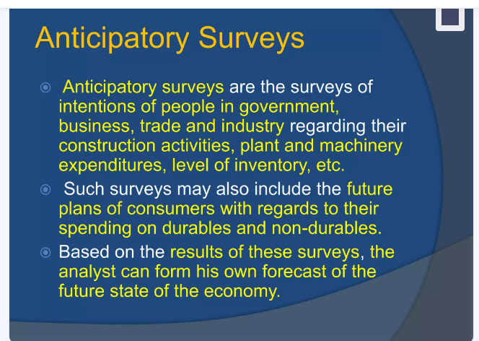

Slide 13
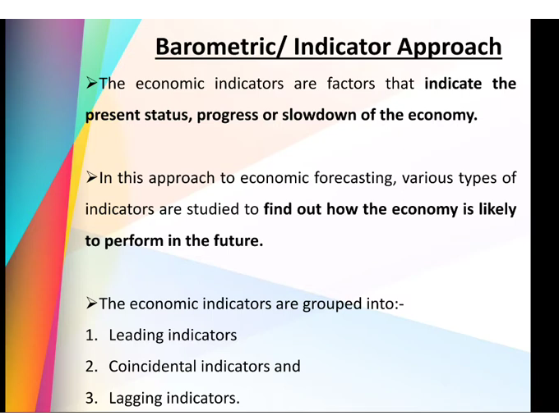

Slide 14
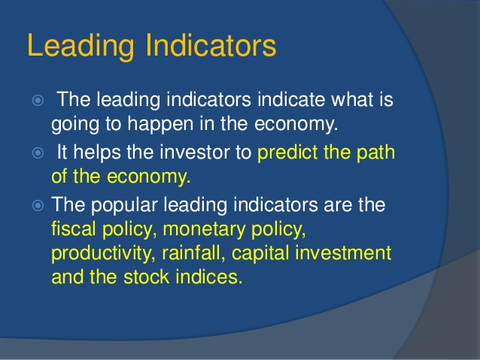

Slide 15
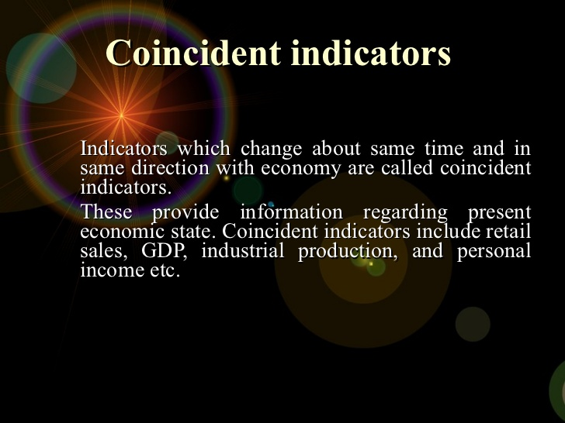

Slide 16
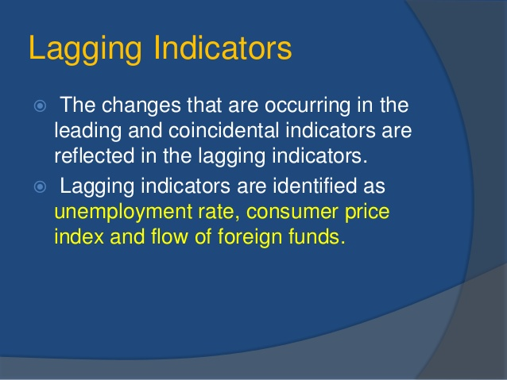

Slide 17
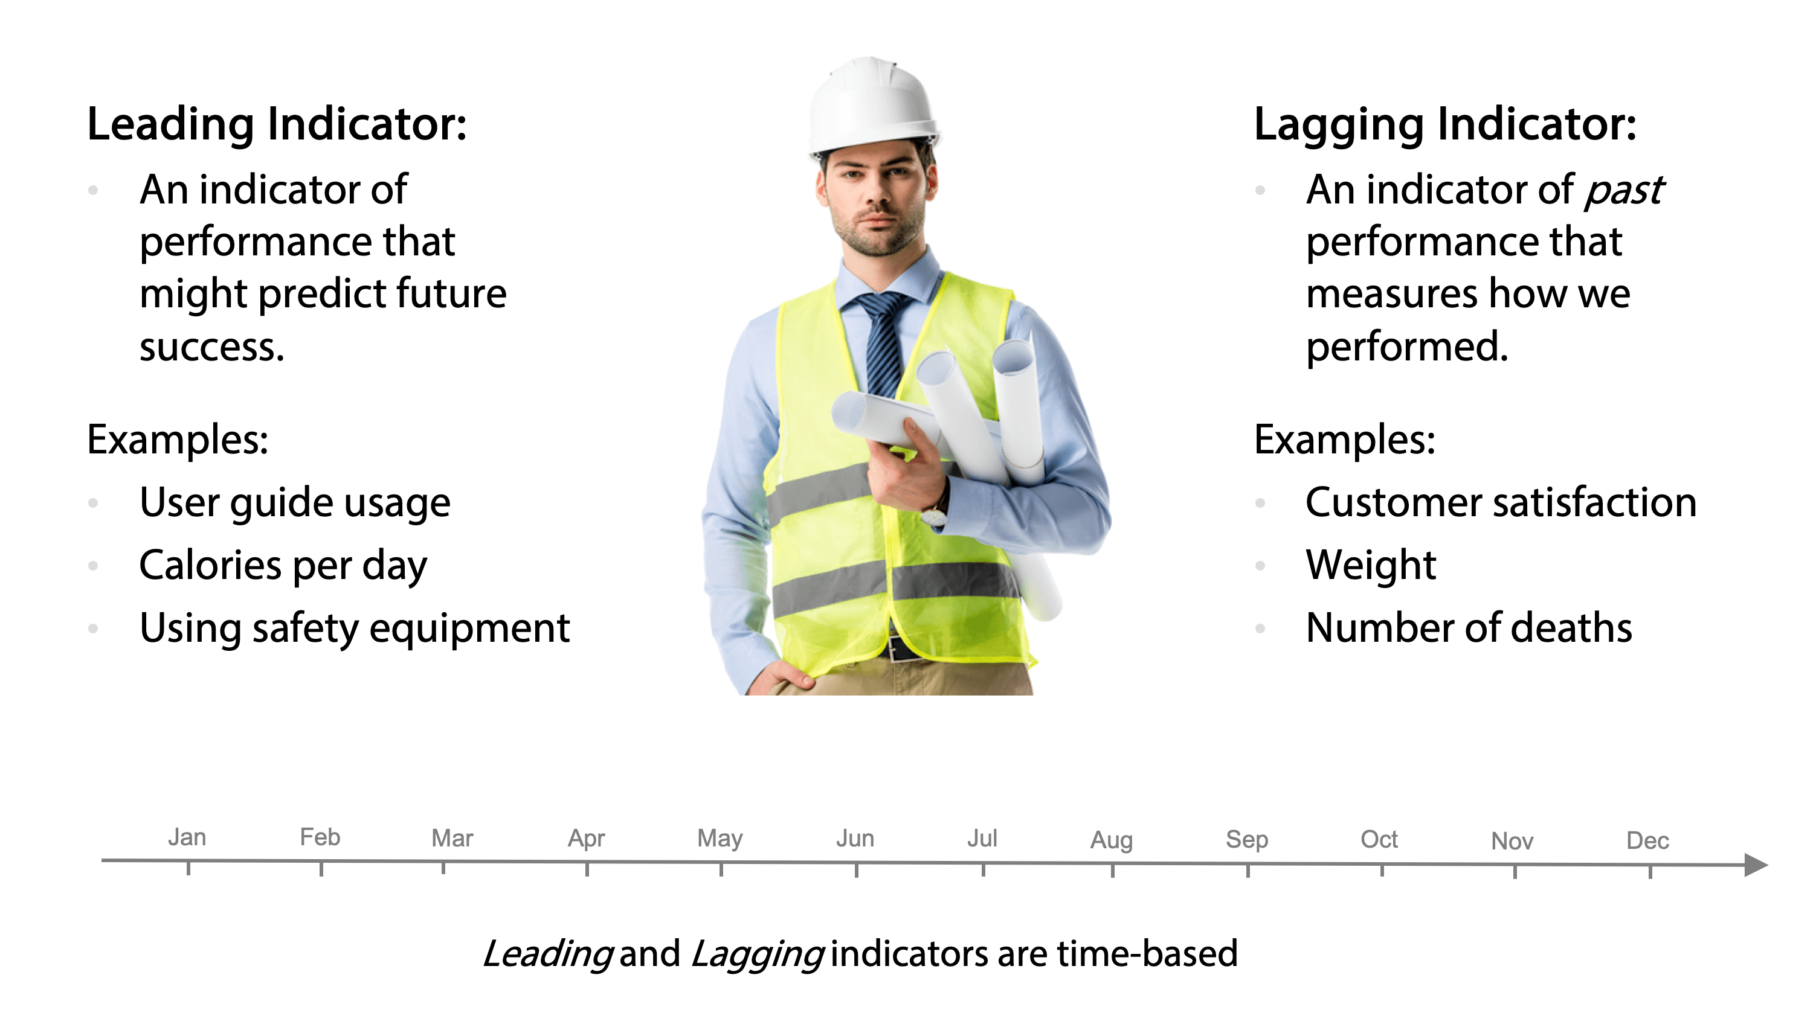

Slide 18
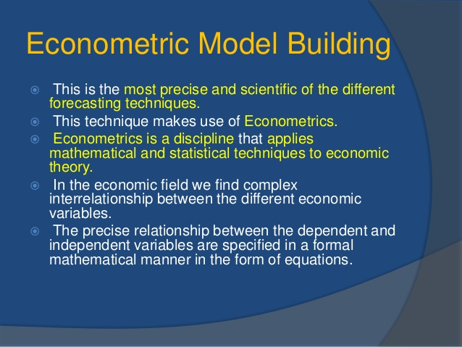

Slide 19
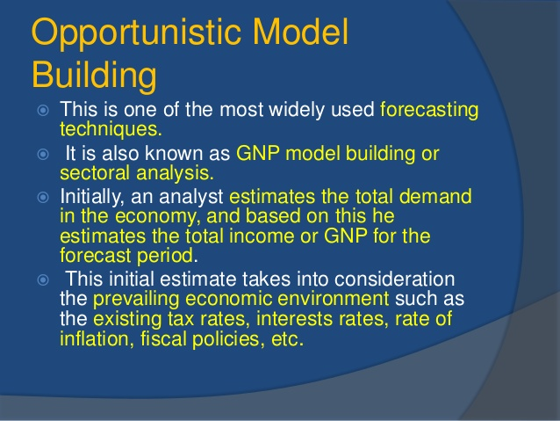

Slide 20


Slide 21
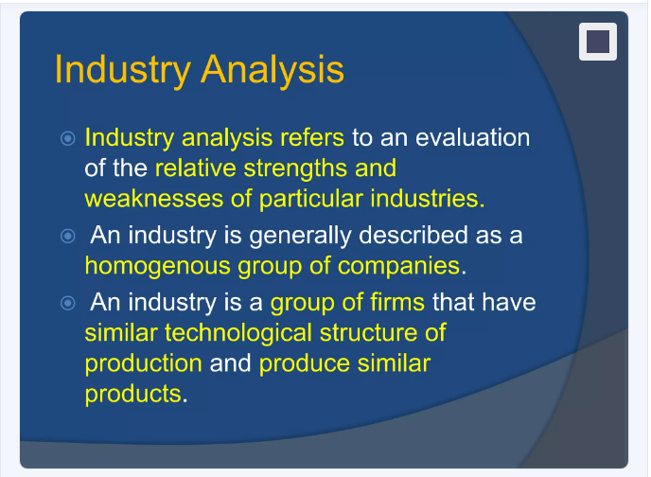

Slide 22
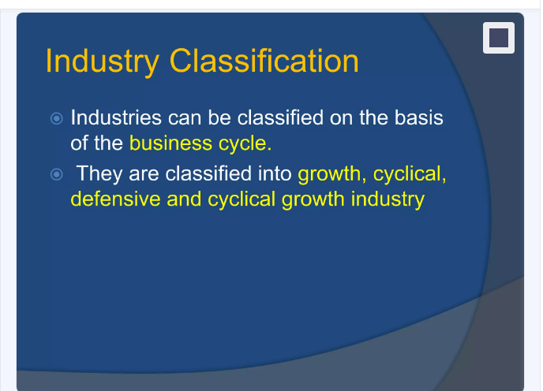

Slide 23
Growth Industry
A growth industry is that sector of an economy which experiences a higher-than-average growth rate as compared to other sectors.
Growth industries are often new or pioneer industries that did not exist in the past. Their growth is a result of demand for new products or services offered by companies in the field. An example of a growth industry is the technology sector
Example; E-commerce, Electric Vehicles Artificial Intelligence (AI) and Machine Learningetc.

Slide 24
Cyclical industries
Cyclical industries are those that experience significant fluctuations in demand and profitability based on the broader economic cycle.
During periods of economic expansion, these industries tend to thrive and see increased demand and profitability.
Conversely, during economic downturns or recessions, they often face decreased demand, reduced profits, and sometimes financial losses.
Examples: Construction and Real Estate Industry, Financial Services Industry etc.

Slide 25
Defensive industries
Defensive industries, also known as non-cyclical industries, are sectors that tend to remain stable regardless of economic conditions.
These industries provide essential goods and services that people continue to need and consume, even during economic downturns.
As a result, defensive industries often experience less volatility in revenues and earnings compared to cyclical industries.

Slide 26
examples
Healthcare Industry
Utilities Industry (electricity, water, natural gas,)
Telecommunications Industry
Food and Beverage Industry

Slide 27
Defensive Industry
A defensive company is a corporation whose sales and earnings remain relatively stable during both economic upturns and downturns. Defensive companies tend to make products or services that are essentials. That is, they are likely to be purchased whether the economy is booming or in a recession.
Eg: Consumers and businesses need the basic necessities of electricity, water, heating and air conditioning whether the economy is in recession or not. Other defensive industries include cable and telecommunications, food retailing, healthcare, and companies involved in the distribution of food and energy.

Slide 28
Cyclical Growth Industry
This is new type of industry that is cyclical and at the same time growing. For
example, the automobile industry experiences periods of stagnation, decline but they
grow tremendously. The change in technology and introduction of new models help the
automobile industry to resume their growth path.

Slide 29
examples
Automotive Industry: The automotive industry produces vehicles and components, benefiting from both technological innovation and economic cycles. It experiences growth due to emerging markets and electric vehicle adoption but remains sensitive to economic conditions.
Renewable Energy Industry: The renewable energy industry focuses on sustainable energy sources like solar, wind, and hydropower. It is a growth industry driven by environmental concerns but can be cyclical due to policy changes and economic conditions.
Travel and Leisure Industry: the travel and leisure industry includes tourism, hospitality, and entertainment. It benefits from global economic growth and rising disposable income but remains sensitive to economic downturns.

Slide 30
Industry life cycle
The industry life cycle is a concept used to describe the stages of growth and development that industries typically go through over time. These stages are similar to the product life cycle but are applied to entire industries rather than individual products.

Slide 31
Introduction Stage
Characteristics:
Innovation and Development: New technology or product is introduced.
High Costs: Significant research and development (R&D) costs, and low initial revenues.
Limited Competition: Few competitors, as the product is new.
Consumer Awareness: Limited awareness and adoption among consumers.
Example Industries: Electric vehicles in their early years, quantum computing, and commercial space travel.
Strategic Focus: Build awareness and educate consumers about the new product or service.
Focus on research and development to refine the offering.
Secure early adopters and influencers to gain traction.

Slide 32
Growth Stage
Characteristics: Rapid Expansion: Demand grows quickly as more consumers become aware.
Increased Competition: More companies enter the market.
Economies of Scale: Production becomes more efficient, reducing costs.
Product Improvement: Ongoing innovation and enhancements.
Example Industries: Renewable energy sources like solar and wind power.
Strategic Focus: Scale operations to meet growing demand and reduce costs.
Differentiate products to stand out in a competitive landscape.
Expand distribution channels and increase market penetration.

Slide 33
Maturity Stage
Characteristics:Market Saturation: Slower growth as the market becomes saturated.
Intense Competition: Companies focus on branding and customer loyalty.
Standardization: Products and services become more standardized.
Incremental Innovation: Focus shifts to improving efficiency and cost control.
Example Industries: Consumer electronics, fast food chains, and soft drinks.
Strategic Focus:Maximize efficiency and control costs to maintain profitability.
Focus on customer retention and loyalty programs.
Explore new market segments or geographic expansion for growth.

Slide 34
Decline Stage
Characteristics: Decreasing Demand: Sales decline as the market becomes oversaturated or obsolete.
Consolidation: Mergers and acquisitions are common as weaker players exit.
Price Competition: Intense price wars reduce profitability.
Innovation Shift: Companies may pivot to new technologies or markets.
Example Industries: Traditional print media, landline telephones, and coal mining.
Strategic Focus:Streamline operations and focus on cost reduction to maintain margins.
Innovate or pivot to new products or markets.
Consider mergers, acquisitions, or divestitures to consolidate resources.

Slide 35
Smartphone industry:
Introduction Stage
When the first smartphones were introduced in the early 2000s, they were groundbreaking but expensive and had limited market penetration.
Companies like BlackBerry and Nokia were early innovators, and consumer awareness was just beginning to grow.
2. Growth Stage
As technology improved and costs decreased, smartphones rapidly gained popularity. Apple's introduction of the iPhone in 2007 was a pivotal moment, leading to a surge in demand.
More competitors entered the market, including Samsung and Google, and smartphone sales grew exponentially as they became a must-have device for consumers around the world.

Slide 36
3. Maturity Stage
By the mid-2010s, the smartphone industry had reached maturity. Most people who wanted a smartphone already had one, and the market became saturated.
Growth slowed, and competition shifted from gaining new customers to retaining existing ones. Innovation became more incremental (e.g., better cameras, faster processors), and companies started focusing on brand loyalty and differentiation through software and services.
4. Decline Stage
Although the smartphone industry is not yet in full decline, signs of the next stage are emerging. Sales growth has plateaued, and some companies have exited the market or shifted focus (e.g., BlackBerry, once a leader, has moved away from making phones). The market is now driven by replacement cycles rather than new customers, and future growth is expected to come from emerging markets or new technologies like foldable screens or augmented reality, rather than traditional smartphones.

Slide 37
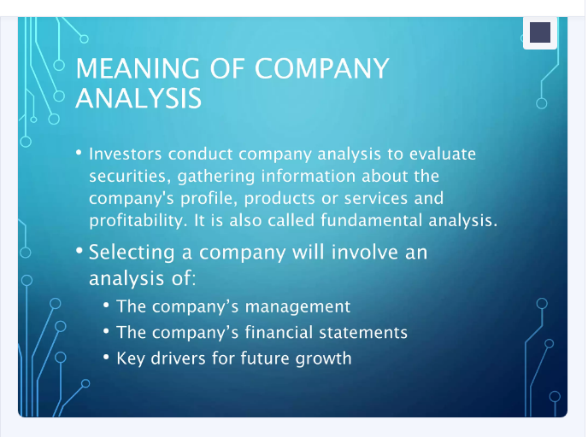

Slide 38
Company Analysis
Evaluates the present and future values of the stock.
The risk and return associated with the purchase of the stock is analysed to take better investment decisions.

Slide 39
The present and future values are affected by a number of factors and they are
Competitive edge Earnings
Capital structure
Management
Operating efficiency
Financial performance

Slide 40
Competitive advantage
The competitiveness of the company can be studied with the help of
The market share
The growth of annual sales
The stability of annual sales

