Slide 1
Talent Management specialist and HR Analytics Officer
Armaan Salik.J
Assistant Professor,
Jamal Institute of Management,
Jamal Mohamed College.

Slide 2
Talent Management specialist
The talent management specialist is responsible to support the talent management team to carry out an effective recruitment plan to ensure that the County is utilizing the best avenues to attract and retain top talent.
Talent specialists identify, engage, develop and retain talent within organisations, to improve the organisation's performance. Every organisation will define 'talent' differently.
A Talent Management Specialist is an essential part of the HR team, all about making the most of the workforce’s skills and making sure the company does a great job of attracting, developing, keeping, and making the best use of talents.

Slide 3
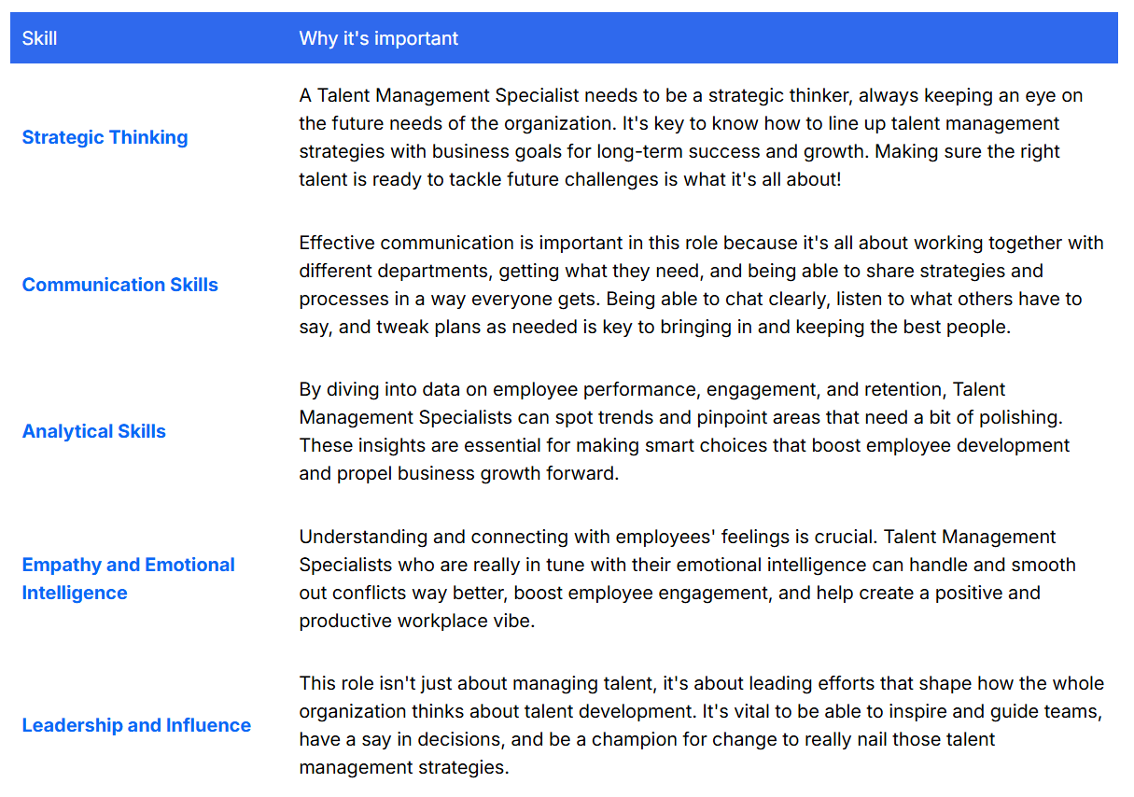
The Top Talent Management Specialist Skills

Slide 4
Talent Management Specialist Duties & Responsibilities:
Create talent acquisition strategies to draw in high-caliber candidates.
Conduct talent assessments to identify skills gaps and opportunities.
Design training programs to enhance employee performance.
Facilitate succession planning for future leadership.
Manage performance appraisals and guide improvement strategies.
Work closely with hiring managers to articulate job specifications.
Remain ahead of industry trends to ensure ongoing enhancement.
Analyze HR data to measure initiative effectiveness.

Slide 5
Talent Management Specialist Requirements:
Bachelor’s degree in Human Resources, Business Administration, or related field.
Proven experience in talent acquisition, assessment, and development.
Possess a solid grasp of HR principles and best practices.
Excellent communication and interpersonal skills.
Ability to design and implement training programs effectively.
Familiarity with succession planning strategies.
Proficient in utilizing HR software and analyzing data.
Demonstrate flexibility in managing shifting priorities within a dynamic setting.

Slide 6
Role of the HR Analyst
The HR analyst plays a crucial role in collecting, structuring, analyzing, and reporting on HR processes and data. In this article, we will discuss the key competencies for an HR analyst’s job, how to become one, career paths, and salary levels.

Slide 7
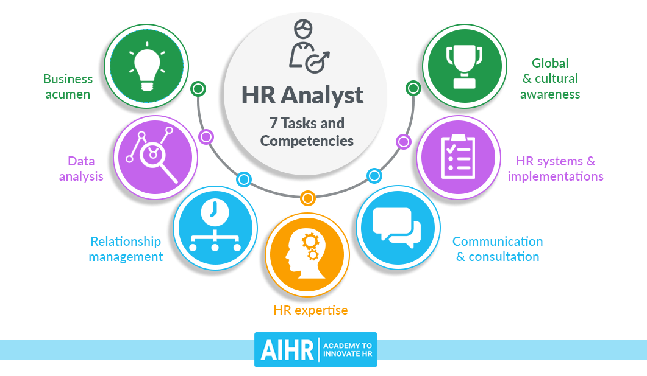

Slide 8
HR analyst job description template
Excellent communication skills and business acumen.
Optimizing and implementing (new) data processes and systems.
Maintain HR data tools, reporting, and dashboards.
Produce and deliver standard (monthly, quarterly, and annual) and customized HR reports.
Respond to HR data requests on an ad hoc basis by gathering, analyzing, and reporting relevant data from various sources.
Maintain HR data integrity by ensuring the accuracy and consistency of input data. Audit HR data and troubleshoot irregularities. Support data governance processes.
Develop & maintain a data glossary,
Responsible for master data entry.
Partner with HR and Payroll on system upgrades and analyses
Responsible for addressing a high volume of system-related activities in a timely fashion while maintaining a high level of quality and internal customer satisfaction

Slide 9
Requirements
Bachelor or master in HR, I/O psychology, economics, econometrics, social science or business administration
X+ years of relevant HR experience
X+ years of relevant HRIS system experience
X+ years of relevant data analytics experience
You can analyze existing and newly collected data
Expert in MS Excel
Experience with data visualizations using either R/Tableau/PowerBI
Experience with statistical modeling and descriptive statistics
If it can be automated, you will
Working knowledge of SQL

Slide 10
Needed Skills
Talent Management
Communication
Training and Development
Performance Evaluation
Data Analysis
Project Management
Conflict Resolution
Coaching and Mentoring
HR Compliance
Organizational Skills
Employee Relations
Leadership Development
Diversity and Inclusion
Talent Acquisition
Employee Recognition
Workforce Planning
Presentation Skills
Reporting
Onboarding
HR Software

