Slide 1
Sales and Operations Planning in SCM –
Enhancing Supply Chain Efficiency through Integrated Planning
Armaan Salik J

Slide 2
Sales and Operations Planning in SCM
Definition:
  S&OP is a management process that aligns supply and demand across functions, ensuring operational efficiency and strategic alignment.
Key Features:
  Cross-functional collaboration.
  Periodic review and updates (e.g., monthly cycles).
  Data-driven decision-making.
Significance in SCM:
  Reduces uncertainty in demand and supply.
  Aligns tactical and strategic objectives.
  Enhances supply chain agility and resilience.

Slide 3
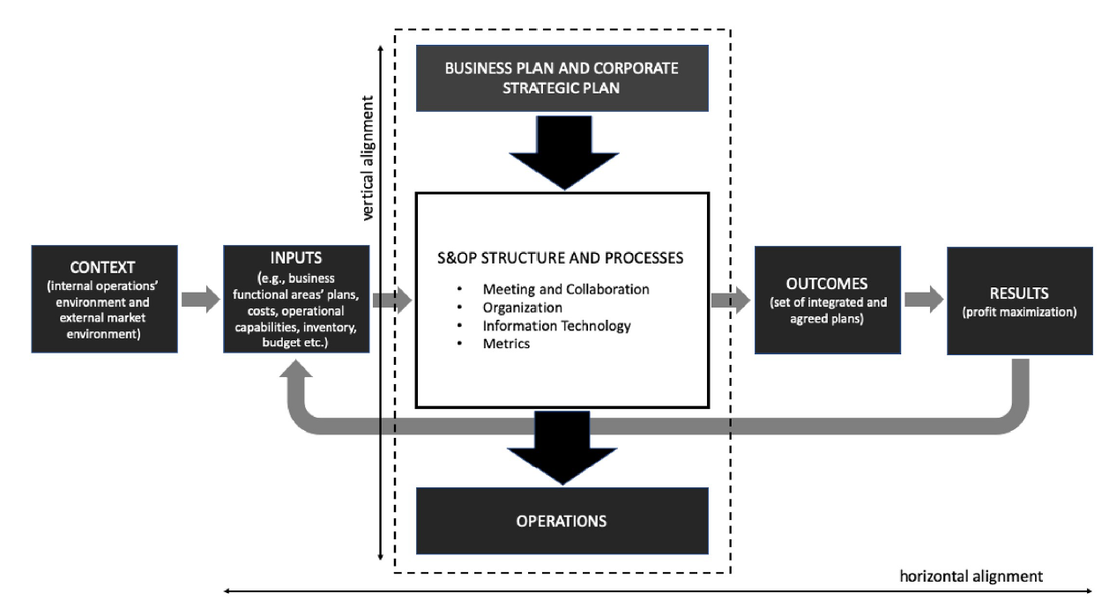

Slide 4
Objectives of S&OP
Demand-Supply Balance:
  Ensure that production plans align with forecasted demand.
Resource Optimization:
  Efficient use of manufacturing, warehousing, and transportation resources.
Customer Satisfaction:
  Improve service levels by ensuring timely deliveries.
Profitability and Performance:
  Minimize costs associated with excess inventory and stockouts.
  Enhance overall supply chain performance metrics.

Slide 5
The S&OP Framework
Local S&OP Steps:
Data Gathering:
  Compile historical data, forecasts, and operational constraints.
  Integrate data from ERP and other systems.
Demand Planning:
  Analyze sales trends and forecasts.
  Incorporate market insights and promotional activities.
Supply Planning:
  Evaluate production capacity and material availability.
  Create constrained supply plans to meet demand forecasts.
Pre-Meeting:
  Identify gaps between demand and supply.
  Develop mitigation plans and trade-off solutions.
Executive Meeting:
  Approve final S&OP plan.
  Align tactical plans with strategic goals.
Global S&OP Steps:
Roll-Up Consolidation:
  Aggregate S&OP plans from all subsidiaries.
  Standardize data for global analysis.
Global Executive Review:
  Align local plans with corporate strategy.
  Monitor global KPIs and identify synergies.

Slide 6
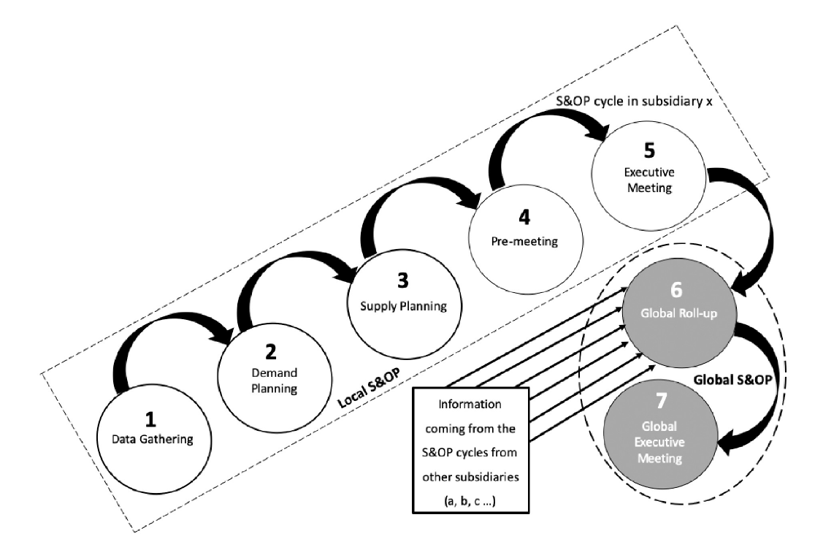

Slide 7
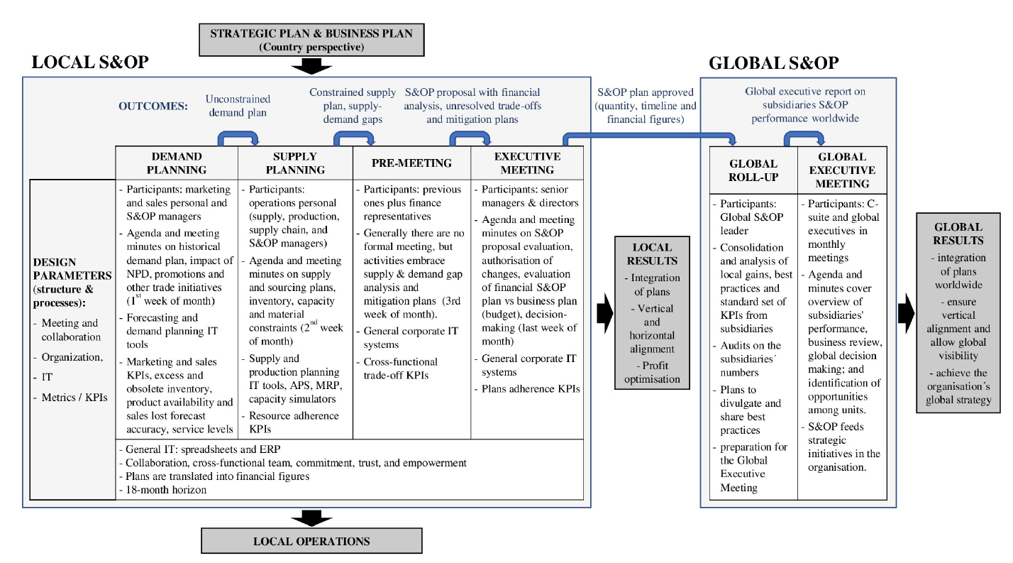

Slide 8
Challenges in S&OP
Data Inconsistencies:
  Subsidiaries use different systems and formats, making integration challenging.
Reporting Standards:
  Lack of standardized KPIs across regions.
Resource Constraints:
  Smaller subsidiaries often lack skilled personnel or adequate tools.
Demand Volatility:
  Rapid market changes complicate forecast accuracy.
Cross-Functional Misalignment:
  Communication gaps between sales, operations, and finance teams.

Slide 9
Solutions for Effective S&OP Implementation
Unified ERP Systems:
  Implement a global ERP system to ensure data consistency.
Standardized KPIs:
  Develop a global dashboard with metrics like forecast accuracy, inventory turns, and service levels.
Benchmarking Best Practices:
  Encourage subsidiaries to share successful strategies.
Training and Development:
  Equip teams with S&OP tools and collaboration skills.
Advanced Analytics:
  Leverage AI and machine learning to improve forecasting accuracy.
Leadership Commitment:
  Ensure active involvement and sponsorship from top management.

Slide 10
Benefits of S&OP in Global SCM
Enhanced global visibility.
Synergies across subsidiaries.
Strategic decision-making at the C-suite level.
Efficient management of large-scale operations.

Slide 11
Future of S&OP in Supply Chains
Integration with advanced analytics and AI.
Dynamic response systems for market changes.
Strengthened cross-disciplinary collaborations.

