Slide 1
Environmental Threat and Opportunity Profile (ETOP)

Slide 2
Introduction to ETOP
ETOP is a strategic analysis tool used to identify environmental factors affecting an organization.
Helps businesses recognize potential threats and opportunities in their external environment.
Essential for proactive strategic planning.

Slide 3
Importance of ETOP
Provides a structured approach to environmental scanning.
Helps organizations align strategies with external factors.
Supports risk mitigation and opportunity maximization.
Enhances decision-making processes.

Slide 4
Components of ETOP
Opportunities: Favorable external factors that an organization can leverage.
Threats: External challenges that can hinder organizational performance.
Categories:
  Economic
  Political & Legal
  Social & Cultural
  Technological
  Ecological
  Competitive Environment

Slide 5
Steps to Develop ETOP
Identify External Factors: Collect data on relevant external elements.
Categorize Factors: Group them into opportunities and threats.
Analyze Impact: Assess how each factor influences business operations.
Develop Strategies: Create plans to minimize threats and maximize opportunities.

Slide 6
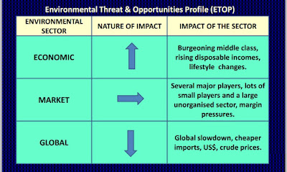
ETOP Matrix

Slide 7
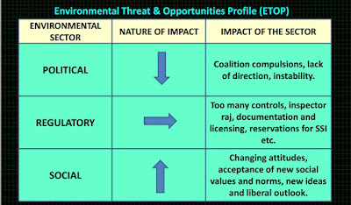
ETOP Matrix

Slide 8
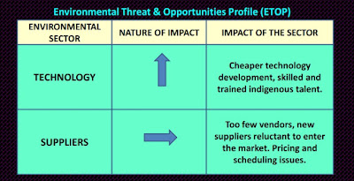
ETOP Matrix

Slide 9
Example of ETOP Analysis
Company: Tesla Inc.
Opportunities:
  Growing demand for electric vehicles.
  Government subsidies for green energy.
  Advancements in battery technology.
Threats:
  High competition from traditional and new automakers.
  Supply chain disruptions.
  Stringent environmental regulations.

Slide 10
Benefits of ETOP
Improves strategic foresight.
Enables competitive advantage.
Encourages proactive rather than reactive decision-making.
Enhances long-term sustainability.

Slide 11
Limitations of ETOP
Requires continuous monitoring of external environment.
Subject to data accuracy and interpretation biases.
External factors can change rapidly, impacting strategy effectiveness.

Slide 12
ETOP vs. SWOT Analysis
ETOP:
  Focuses only on external environmental factors.
  Used for detailed strategic planning.
SWOT Analysis:
  Covers both internal and external factors.
  Provides a broader but less detailed view.

Slide 13
Implementing ETOP in Business Strategy
Integrate ETOP findings into business strategy.
Align resource allocation with identified opportunities and threats.
Develop contingency plans for potential risks.
Continuously update ETOP analysis for relevance.

Slide 14
Conclusion
ETOP is a critical tool for strategic management.
Helps organizations navigate external challenges effectively.
Should be used alongside other strategic tools for comprehensive planning.

