Slide 1

DR. F. WAHIDHA BEGUM
ASSISTANT PROFESSOR
JAMAL INSTITUTE OF MANAGEMENT
JAMAL MOPHAMED COLLEGE

Slide 2
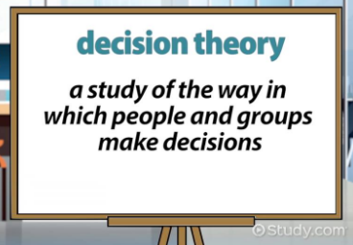

Slide 3
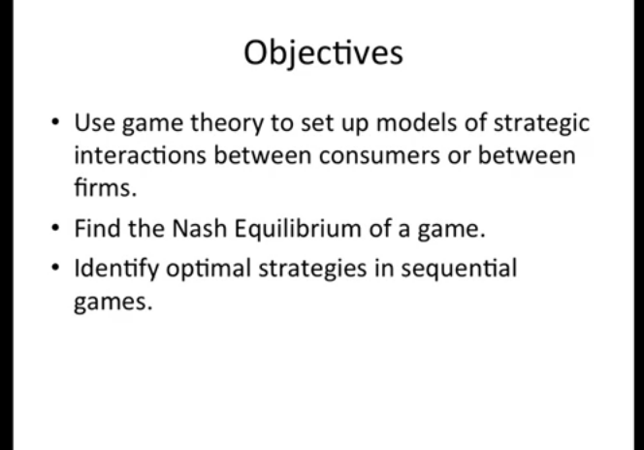

Slide 4


Slide 5


Slide 6
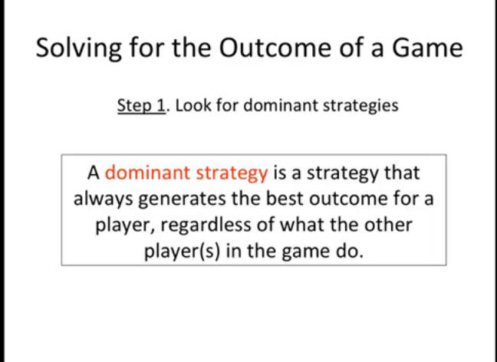

Slide 7
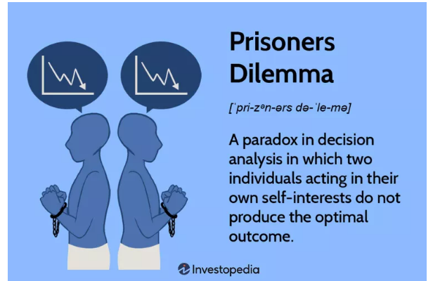

Slide 8
The prisoner’s dilemma presents a situation where two parties, separated and unable to communicate, must each choose between cooperating with the other or not. The highest reward for each party occurs when both parties choose to co-operate
The concept of the prisoners’ dilemma was developed by RAND Corporation scientists Merrill Flood and Melvin Dresher and was formalized by Albert W. Tucker, a Princeton mathematician..

Slide 9
The story behind the prisoner’s dilemma
Two bank robbers, Elizabeth and Henry, have been arrested and are being interrogated in separate rooms.
The authorities have no other witnesses, and can only prove the case against them if they can convince at least one of the robbers to betray their accomplice and testify to the crime.
Each bank robber is faced with the choice to cooperate with their accomplice and remain silent or to defect from the gang and testify for the prosecution.

Slide 10
If they both co-operate and remain silent, then the authorities will only be able to convict them on a lesser charge resulting in one year in jail for each (1 year for Elizabeth + 1 year for Henry = 2 years total jail time).
If one testifies and the other does not, then the one who testifies will go free and the other will get five years (0 years for the one who defects + 5 for the one convicted = 5 years total).
However, if both testify against the other, each will get three years in jail for being partly responsible for the robbery (3 years for Elizabeth + 3 years for Henry = 6 years total jail time).

Slide 11
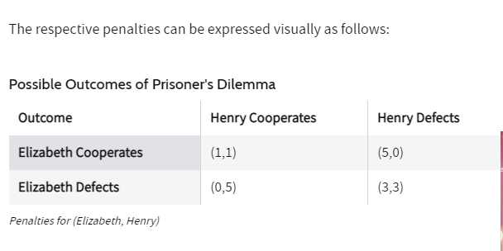

Slide 12
In this case, each robber always has an incentive to defect, regardless of the choice the other makes.
From Elizabeth's point of view, if Henry remains silent, then Elizabeth can either co-operate with Henry and do a year in jail, or defect and go free. Obviously, she would be better off betraying Henry in this case.
On the other hand, if Henry defects and testifies against Elizabeth, then her choice becomes either to remain silent and do five years or to talk and do three years in jail. Again, obviously, she would prefer to do the three years over five.

Slide 13
In both cases, whether Henry cooperates with Elizabeth or defects to the prosecution, Elizabeth will be better off if she defects and testifies. Now, since Henry faces the exact same set of choices he also will always be better off defecting as well.

Slide 14
Contd
The paradox of the prisoner’s dilemma is this: both robbers can minimize the total jail time that the two of them will do only if they both cooperate and stay silent (two years total), but the incentives that they each face separately will always drive them each to defect and end up doing the maximum total jail time between the two of them of six years total.

Slide 15
Conclusion
The prisoner’s dilemma is a scenario in which the gains from cooperation are larger than the rewards from pursuing self-interest. It applies well to oligopoly.

Slide 16
Nash Equillibrium
Nash equilibrium is named after its inventor, John Nash, an American mathematician.
The Nash equilibrium states that the optimal strategy for an actor is to stay the course of their initial strategy while knowing the opponent’s strategy and that all players maintain the same strategy.
Nash equilibrium in game theory is a situation in which a player will continue with their chosen strategy, having no incentive to deviate from it, after taking into consideration the opponent’s strategy.

Slide 17
In economic theory, the Nash equilibrium is used to illustrate that decision-making is a system of strategic interactions based on the actions of other players. It can be used to model economic behavior to predict the best response to any given situation.

Slide 18
Example of Nash Equilibrium
Imagine a game between Tom and Sam. In this simple game, both players can choose strategy A, to receive $1, or strategy B, to lose $1. Logically, both players choose strategy A and receive a payoff of $1.
If you revealed Sam’s strategy to Tom and vice versa, you see that no player deviates from the original choice. Knowing the other player’s move means little and doesn’t change either player’s behavior. Outcome A represents a Nash equilibrium.

Slide 19
If you revealed Sam’s strategy to Tom and vice versa, you see that no player deviates from the original choice. Knowing the other player’s move means little and doesn’t change either player’s behavior. Outcome A represents a Nash equilibrium.

Slide 20
