Slide 1

Porter's Five Forces Model:
A Strategic Framework Understanding Industry Dynamics And Competitiveness
Armaan Salik Jain Alaudeen
Assistant Professor,
Jamal Institute of Management,
Jamal Mohamed College.

Slide 2

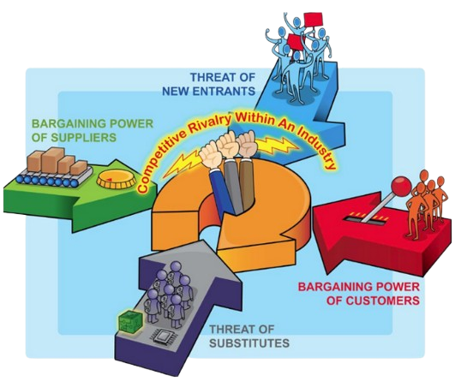
Porter's Five Forces Model
Developed by Michael E. Porter.
A framework for analyzing the competitive forces shaping every industry.
Purpose: To assess industry profitability and develop business strategies.
Why Use It?
Helps identify the strengths and weaknesses of an industry.
Aids in strategic decision-making.

Slide 3
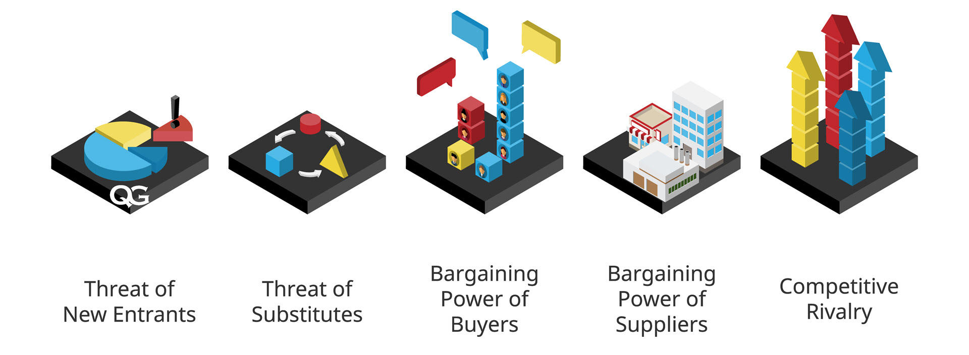
The Five Forces Model

Slide 4
Overview of the Five Forces
Threat of New Entrants: How easily new competitors can enter the market.
Bargaining Power of Suppliers: Suppliers’ influence on cost and availability of inputs.
Bargaining Power of Buyers: Customers’ influence on pricing and quality.
Threat of Substitutes: The risk of alternative products/services replacing current offerings.
Industry Rivalry: The intensity of competition among existing firms.

Slide 5

Force 1 - Threat of New Entrants
Key Factors:
Economies of scale.
Capital requirements.
Access to distribution channels.
Regulatory policies.
Brand loyalty.
Implications:
High barriers to entry deter new competitors.
Low barriers increase competition and reduce profitability.

Slide 6

Force 2 - Bargaining Power of Suppliers
Key Factors:
Number of suppliers.
Uniqueness of inputs.
Switching costs for companies.
Supplier’s ability to integrate forward.
Implications:
Strong suppliers can raise input costs and squeeze margins.
Weak suppliers offer better negotiating power to companies.

Slide 7

Force 3 - Bargaining Power of Buyers
Key Factors:
Number of buyers vs. sellers.
Product differentiation.
Price sensitivity.
Buyer’s ability to integrate backward.
Implications:
Powerful buyers demand lower prices or higher quality.
Weak buyers limit market influence on pricing.

Slide 8

Force 4 - Threat of Substitutes
Key Factors:
Availability of alternative products/services.
Price-performance trade-offs of substitutes.
Switching costs for customers.
Implications:
High threat reduces industry attractiveness.
Differentiation and innovation help mitigate risks.

Slide 9

Force 5 - Industry Rivalry
Key Factors:
Number of competitors.
Industry growth rate.
Fixed costs vs. variable costs.
Product differentiation.
Implications:
Intense rivalry decreases profitability.
Differentiation and niche strategies reduce direct competition.

Slide 10
Strategic Implications of Five Forces
Positioning for Competitive Advantage:
Identify and occupy a niche market where competition is minimal.
Focus on building strong brand loyalty to create barriers for new entrants.
Leverage unique resources or capabilities to reduce dependency on suppliers.
Investment Strategies:
Invest in innovation and technology to reduce the threat of substitutes.
Develop economies of scale to lower costs and deter new entrants.
Strengthen supply chain relationships to ensure favorable terms.
Adaptability and Responsiveness:
Continuously monitor industry trends to anticipate changes in competitive dynamics.
Foster a culture of flexibility and rapid decision-making to respond to market shifts.
Build strategic alliances or partnerships to enhance competitive positioning.
Risk Mitigation:
Diversify product lines or market segments to spread risk.
Develop contingency plans to address supplier or buyer power shifts.
Invest in research and development to stay ahead of substitutes and competitors.

Slide 11

Conclusion
Porter's Five Forces is a robust tool for strategic planning.
Each force provides insights into industry dynamics.
Success depends on leveraging the forces to your advantage.

