Slide 1
PRESENTED BY,
K.VIJAYALAKSHMI,
ASSISTANT PROFESSOR OF MICROBIOLOGY,
JMC,TRICHY-20.

Slide 9
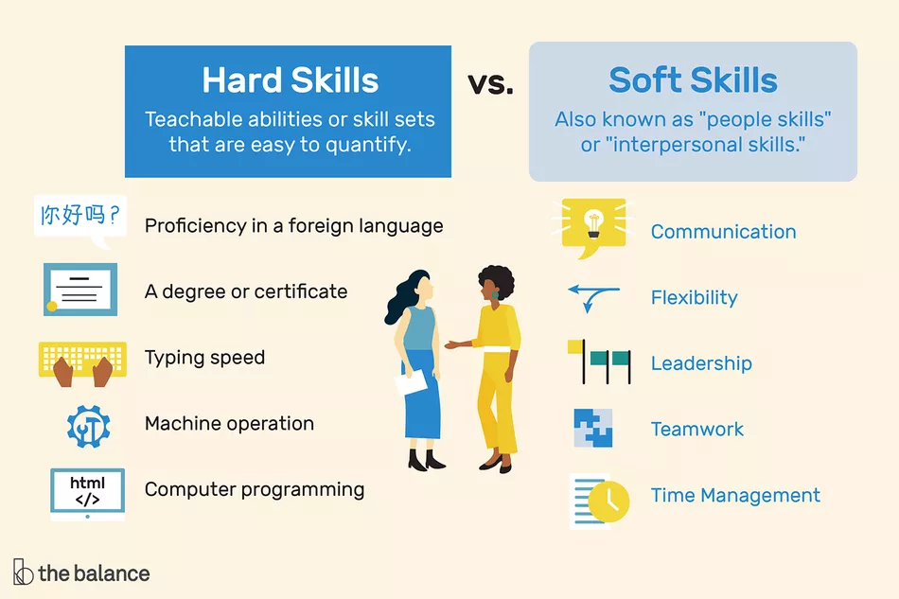

Slide 10
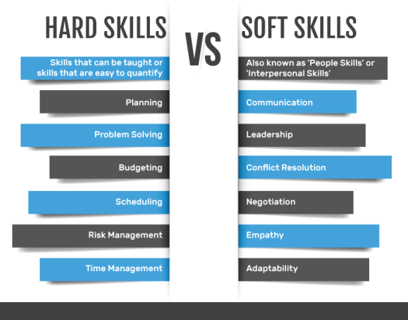

Slide 13
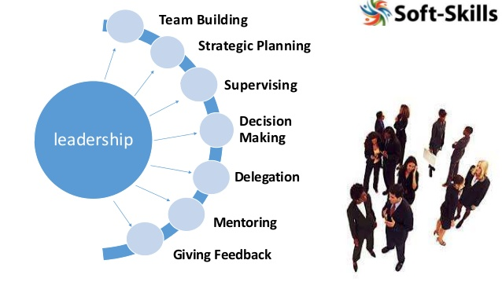

Slide 14
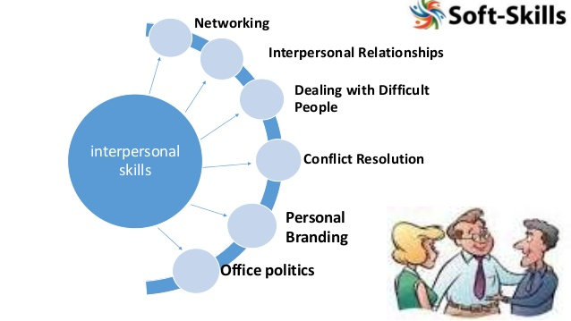

Slide 15
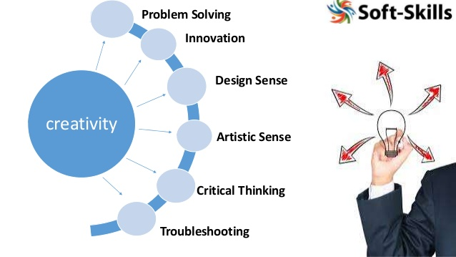

Slide 16
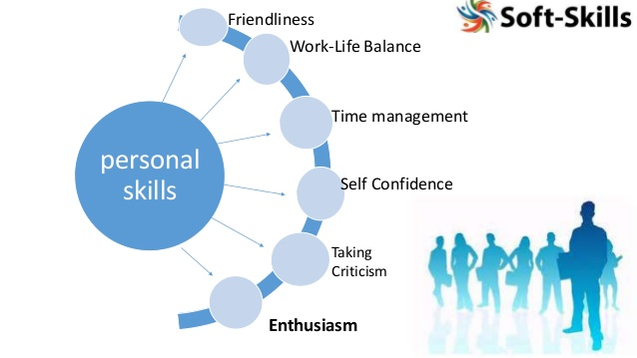

Slide 18
